Slide 1


Telemedicine:
“Understanding the different models in the market and how utilization affects the bottom line.”

Slide 2

Agenda
The Future of Telemed
Telemed Overview
Provider Networks
Methods of Access
2 Different Models of Telemed
Carrier vs Independent Provider
Value to Employers
Value to Employees
Utilization
Marketing and Engagement
Keys to Selecting the Right Telemed Partner
Additional Telehealth Services
Q&A

Slide 3

The Future of Telemed
Telehealth Is becoming healthcare (and vice versa)
MAGAZINE
Here’s What Your Future Doctor Visits Could Look Like
“
Tomorrow’s office visit will increasingly take place everywhere but the office.”
Dr. Eric Topol
May 2nd 2017
Source: Fortune, Ray Dorsey/Eric Topol - http://fortune.com/2017/05/02/brainstorm-health-2017/

Slide 4

The Future of Telemed
Almost all large employers are offering telehealth
96% of large employers will make telehealth services available in 2018
More than half of large employers will offer telehealth for behavioral health services
56% offering
behavioral health
44% not offering behavioral health
Source: National Business Group on Health, Large Employers’ 2018 Health Care Strategy and Plan Design Survey

Slide 5
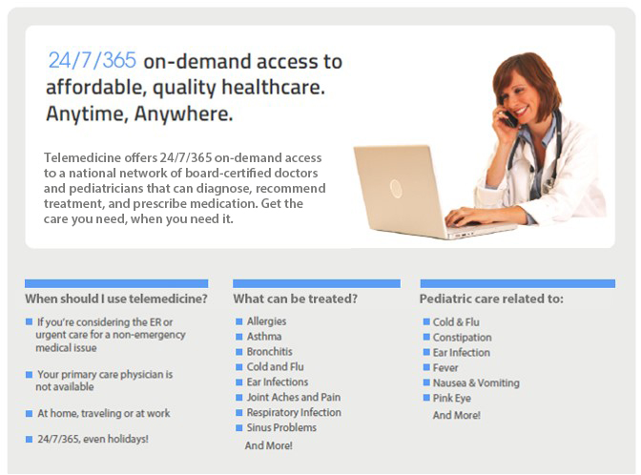
Telemedicine Overview

Slide 6








Methods of Access
By Phone
Step 1: Call Toll-Free
A patient calls a toll-free hotline that’s available 24/7/365.
Step 2: Speak with a Care Coordinator
A care coordinator evaluates the patient to determine if telehealth is appropriate and redirects the patient to a doctor if appropriate.
Step 3: Speak with the Doctor
Once an available provider is located, our system automatically calls and connects the doctor to the customer.
By Video Conference
Step 1: Visit Website
Customer visits our website and logs in using their username and password.
Step 2: Find a Doctor
Our system helps the customer determine if telehealth is appropriate. Searches for a provider using criteria, such as specialty, language, gender, location, or simply find the next
available doctor.
Step 3: See the
Doctor Online
Once an available provider is located, our system automatically connects the doctor to the customer via our online portal.
By Mobile App
Step 1: Open Mobile App
Customer opens mobile app and logs in using their username
and password.
Step 2: Find a Doctor
Our system helps the customer determine if telehealth is appropriate. Searches for a provider using criteria, such as specialty, language, gender, location, or simply find the next available doctor.
Step 3: See the Doctor On Your Smartphone
Once an available
provider is located, our system automatically connects the customer to the doctor via their smartphone.

Slide 7




Phone
BY PHONE
Step 1: Call Toll-Free
A patient calls a toll-free hotline that’s available 24/7/365.
Step 2: Speak with a Care Coordinator
A care coordinator evaluates the patient to determine if telehealth is appropriate and redirects the patient to a doctor if appropriate.
Step 3: Speak with the Doctor
Once an available provider is located, our system automatically calls and connects the doctor to the customer.
Average Call Back Time: 9 Minutes
94% of All Calls Resolved
Speak with a US Board Certified Physician
100% HIPAA Compliant
Transcript of your call is sent via Electronic Medical Records to your physician on file
Prescription called into your local pharmacy, (when applicable)

Slide 8
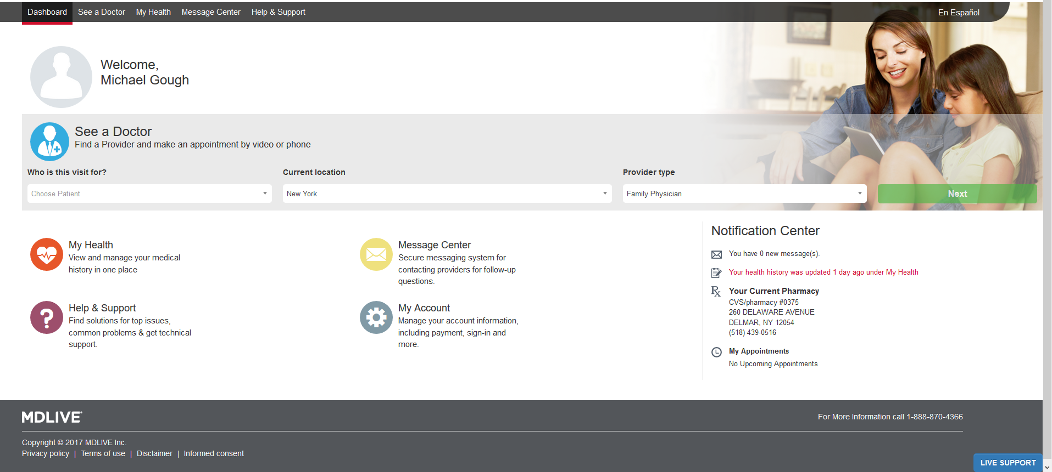
Patient Portal

Slide 9
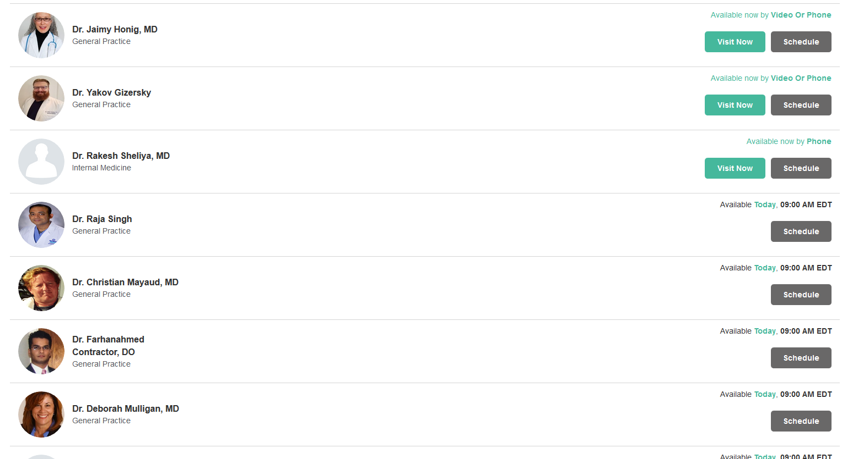
Select Your Doctor

Slide 10
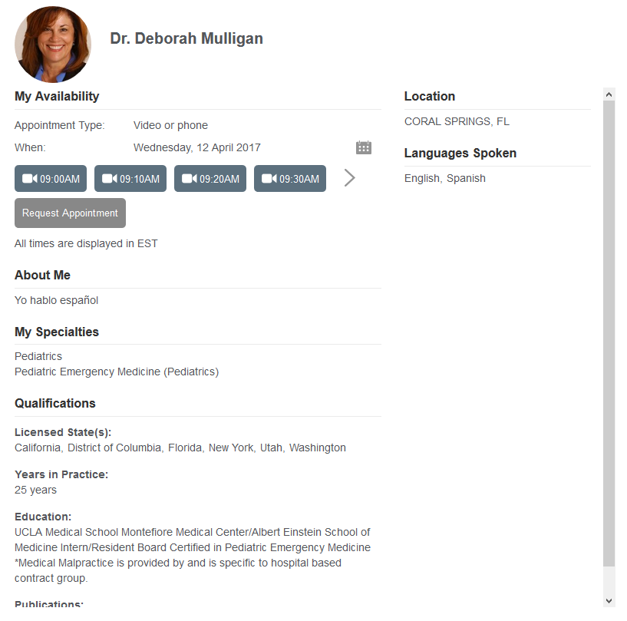
View Physician Profile

Slide 11
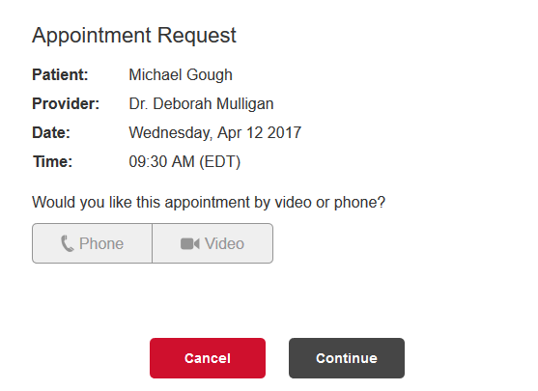
Book your Appointment

Slide 12
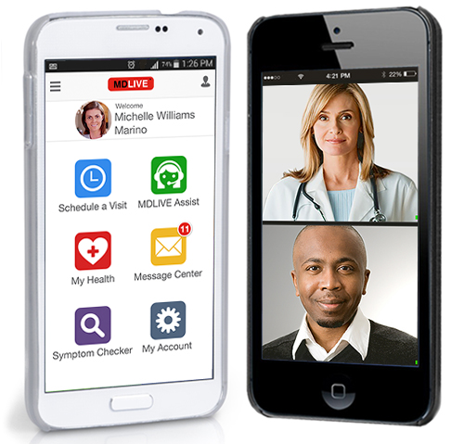
Mobile Engagement
Access to online care at home, at work or on the go
Telehealth in the palm of your hand
Engage with providers from iPhone, iPad, Windows Mobile & Android
Schedule Appointments
Complete Medical History
Send and Receive secure messages
Symptom Checker
MDLIVE Assist

Slide 13

Co-Pay Model
Who?
Most Insurance Carriers
Telemed “Carriers”
Cost:
Low or zero monthly fee
$40-$59 co-pay per consultation
Communication:
Very little communication, marketing or awareness
Results:
Very low utilization
National Average of 2%-3%
Risk:
Low
Return on Investment
None or extremely low
Guarantee:
None

Slide 14


$0 Co-Pay Model
Who?
Solution based Telemed Companies
Cost:
Low monthly fee
$0 co-pay
Communication:
Very high level communication, marketing or awareness and employee engagement.
Results:
Industry leading utilization
40+% utilization
Risk:
None
Return on Investment
Very high
Guarantee:
100% Guarantee to recoup all costs
Potential for much higher return

Slide 15
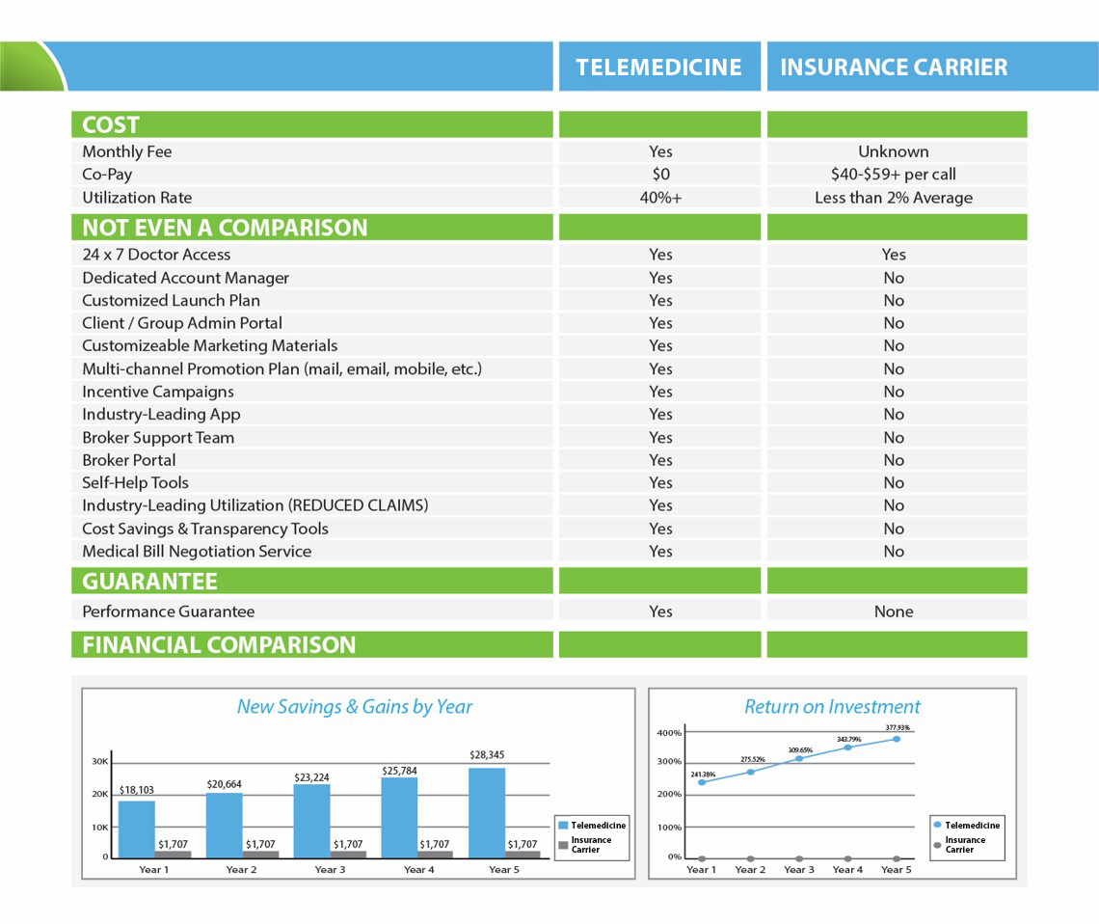
Carrier Model vs Independent Model

Slide 16
Advantages For Employers
Redirecting in person medical visits to telemedicine services significantly lowers claim costs
ER Visit
$1,500
Telemedicine
$0
$1,500 Savings
Urgent Care
$160
$0
Telemedicine
$160 Savings
PCP Visit
$130
$130 Savings
Telemedicine
$0

Slide 17
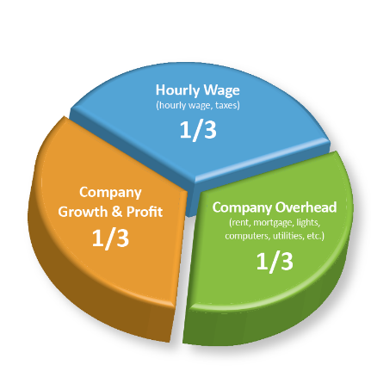
Advantages For Employers
Convenient access to care improves productivity – reducing visit times and getting employees back to work faster.
  Multiply an Employee's Hourly Rate X 3 to Calculate True Company Cost.
  An Employee being paid $20/Hour needs to produce $60/hour for their company.
    Example: $20/hour Wage = $60/hour in Productivity to the company.
    Missed Work: Someone that is out of work for 4 hours, costs the company $240.

Slide 18

Employee Benefits
Save co-pays
Avoid paying 100% of costs (high deductibles)
Care for kids from comfort of your own home
Great benefit for families
Avoid unpaid leave
Save sick time
More productive

Slide 19
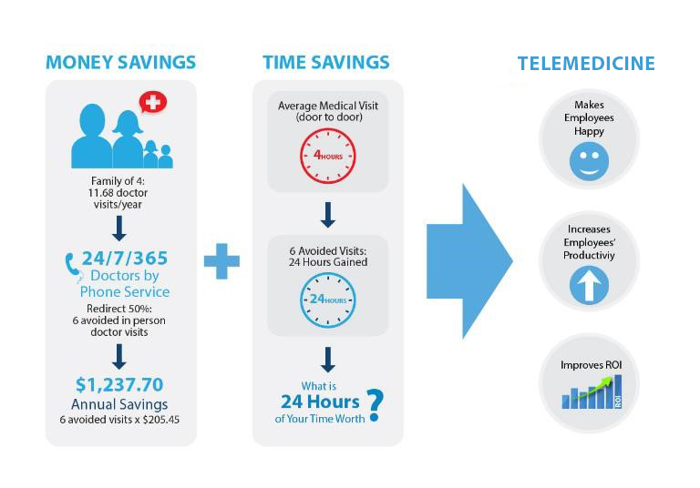



Utilization = Key to ROI & Value
Utilization Drives Savings and ROI

Slide 20
Keys To Engagement
Benefit Design:
$0 Co-pay model is the key
Copays and consult charges have a negative impact on utilization
Free consult model creates industry leading utilization
Engagement Campaign:
Robust comprehensive 12-month communication campaign toolkit is critical
Customized for each client to ensure our program fits your employee population
Assigned Account Manager to work with you on designing comprehensive program
Incentives:
Customization for each client to design additional incentive programs as appropriate for your culture, program goals and budget00
Assigned Account Manager works with each client to design a program that is right for your goals and culture.

Slide 21
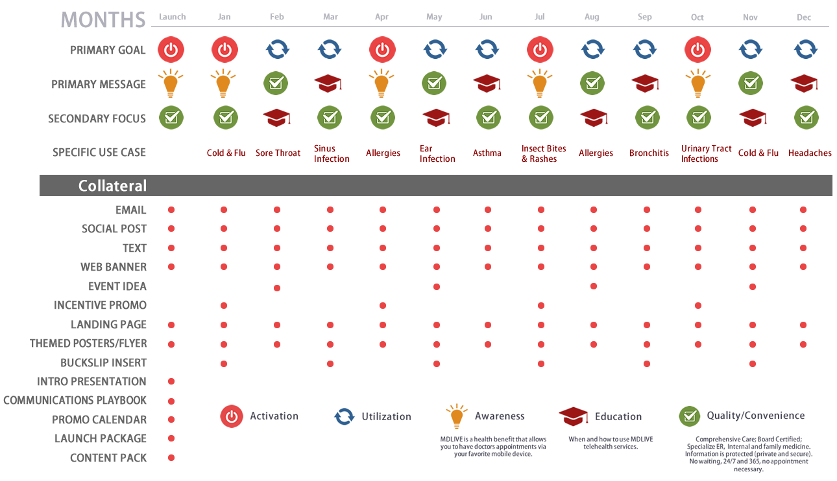
12 Month Engagement Campaign
Account Management Promotion Campaign Highlights:
Communication to employees drives utilization, which drives savings
Support with all necessary marketing designs, e-newsletters, promotion strategies, etc.
Materials available in Spanish also
Turnkey marketing materials available free of charge on password-protected Group Admin Portal and also mailed to Group Admin at beginning of campaign

Slide 22
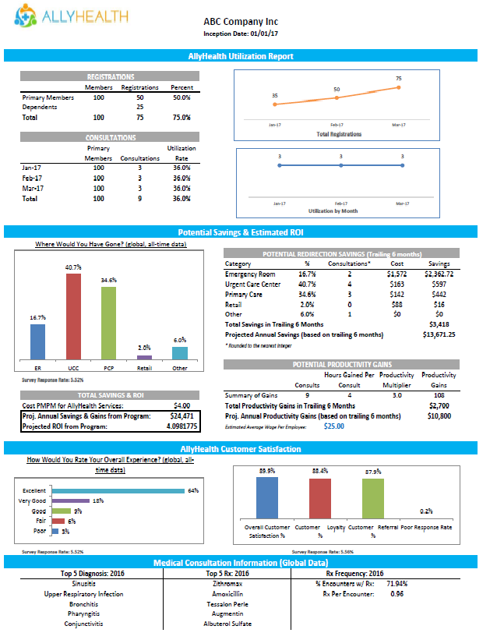
Quarterly Client Reports
Quarter and YTD
Specific to eligible population
  Activation & Registration numbers
  Performance against goals
  Proactive recommendations based on each clients’ reporting

Slide 23
Keys to Selecting the Right
Telemed Partner
Large and proficient doctor network.
Preferred $0 Co-Pay Model.
Multiple methods of access.
Very Robust Marketing and Engagement Strategy. (this is critical)
Support for employer group admin, employees and broker.
Performance guarantee.

Slide 24
A Healthy Workforce for a Healthier Bottom Line
THANK YOU!
Michael P. Gough
Vice President
AllyHealth
215-543-7981
mike@allyhealth.net
Notes:
Remove draft deck.

