Slide 1
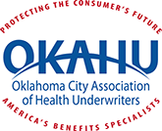
Health Literacy: The Sleeping Giant of Health Improvement and Cost Containment
OKAHU Spring Symposium
April 11, 2019

Slide 2
The Question
Can we really control the cost of healthcare?

Slide 3

Health Care Cost Institute
2017 Health Care Cost and Utilization Report
HCCI draws on the health care claims of more than 40 million Americans, one of the largest and most complete databases of its type. This report provides a one-of-a-kind view into health care spending, use, and prices for individuals under 65 covered by employer-sponsored insurance (ESI).

Slide 4
Background
CompMed/CommunityCare
HCA/CCN
CompOne Services/COPA
Physician Direct ePPO
MedEncentive
Co-Founders:
  Jeff Greene, Human Factors Engineer
  Susan Chambers, MD
  David Parke, MD

Slide 5
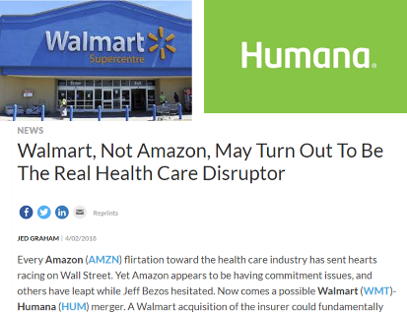
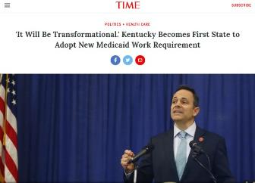
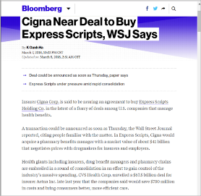
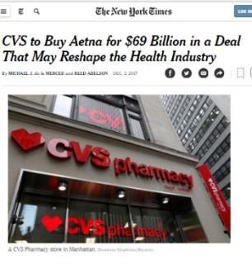
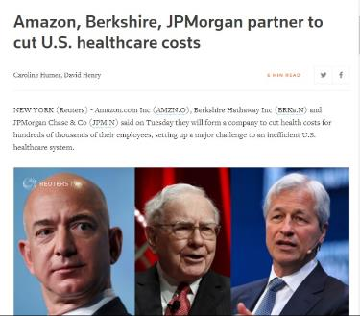
A Time for Disruption

Slide 6
Amazon/Berkshire Hathaway/J.P. Morgan Chase Announcement
Of the Amazon/Berkshire Hathaway/J.P. Morgan Chase partnership to address the healthcare cost crisis in our country.
Warren Buffett said:
  “The ballooning costs of healthcare act as a hungry tapeworm on the American economy.”
© 2018 MedEncentive, LLC. All Rights Reserved

Slide 7
How well have these methods worked at controlling costs?
PPOs
HMOs
Consumer Directed Health Plans
Wellness
Accountable Care Organizations
Meaningful Use
Pay for Performance
Patient Centered Medical Home
Notes:
ACOs: health systems have huge amounts of bonds to service

Slide 8
What are we trying to solve? Precisely defining the problem to ensure success
Managed care: controlling healthcare costs
Triple Aim: better health, better healthcare and cost containment
Quadruple Aim: add – doctor and patient fulfillment
The “Ultimate Objective”

Slide 9
The “Ultimate Objective”
The precisely defined “ultimate objective” expands the Triple/Quadruple Aim to mean a solution that:
not only improves the overall health of a population to reduce the demand for healthcare;
makes healthcare better and less expensive;
generates proven and unambiguous, per capita healthcare cost savings; and
offers fulfillment to patients and their medical providers; but
is also simple, fast-acting, and durable;
is scalable, which means easy to implement and maintain, and relatively inexpensive;
applies to a whole community, which means a full and normally distributed population, and not merely an isolated subset;
results in a true return on investment for the sponsoring health plan; and
is socially acceptable and sustainable.
© 2018 MedEncentive, LLC. All Rights Reserved

Slide 10
Where do we start?
Health literacy is the single strongest determinant of health status, well-being, life expectancy and how much health care a person will consume in a lifetime.
© 2018 MedEncentive, LLC. All Rights Reserved

Slide 11
The Importance of Health Literacy
World Health Organization: “Health literacy is a stronger predictor of an individual’s health status than income, employment status, education level and racial or ethnic group.”
© 2018 MedEncentive, LLC. All Rights Reserved

Slide 12

Study Associating Low or Limited Health Literacy and Lower Medication Adherence
The effect of the content of the knowledge on adherence to medication in hypertensive patients
Uzun M, et al, 2009
https://www.researchgate.net/publication/26286730_The_effect_of_the_content_of_the_knowledge_on_adherence_to_medication_in_hypertensive_patients
“Patient knowledge about hypertension and medications is associated with higher adherence rates. “
This study helps substantiate MedEncentive’s effectiveness.

Slide 13
Patient Non-Adherence to Medications

Slide 14

Study Associating Health Literacy and Hospitalizations
Functional health literacy and the risk of hospital admission among Medicare managed care enrollees
Baker DW et al, 2002
https://www.ncbi.nlm.nih.gov/pubmed/12144984
Low health literacy is associated with higher rates of hospitalizations
“Inadequate literacy was an independent risk factor for hospital admission ...”
This study helps substantiate THAM’s effectiveness.

Slide 15

Study Associating Health Literacy and
Emergency Room Visits/Hospitalizations
The Association of Health Literacy With Preventable Emergency Department Visits: A Cross-sectional Study
Balakrishnan MP et al, 2017
http://onlinelibrary.wiley.com/doi/10.1111/acem.13244/epdf
“Limited health literacy is a risk factor for potentially preventable ER visits, particularly those that result in hospital admission.”
This study helps substantiate THAM’s effectiveness.
Low health literacy is associated with higher rates of preventable emergency room visits

Slide 16

Impact of Low Health Literacy on Medical Costs
Involving over 92,000 vets, the largest health literacy to medical cost study, to date.
This study helps substantiate MedEncentive’s effectiveness.

Slide 17
Impact of Low Health Literacy on Medical Costs
Nearly a 2x difference!

Slide 18
Inadequate health literacy is prevalent in the U.S.
Only 1 in 9 Americans have proficient health literacy
Source: U.S. Department of Education, Institute of Education Sciences, 2003 National Assessment of Adult Literacy.

Slide 19
Health literacy has been largely ignored and underrated…
“If inadequate health literacy is harmful, expensive and prevalent, then why is it overlooked and undervalued?”
© 2018 MedEncentive, LLC. All Rights Reserved

Slide 20
Four reasons health literacy is overlooked and undervalued…
The impacts of health literacy are not widely known
It seems too simplistic
It is not in the best interest of key stakeholders
Viable solutions to improve health literacy are non-existent
© 2018 MedEncentive, LLC. All Rights Reserved

Slide 21
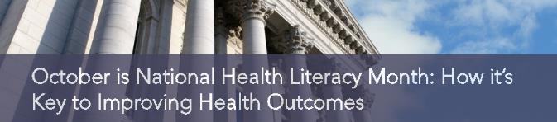
#1. The impacts of health literacy are not widely known…IS CHANGING

Slide 22
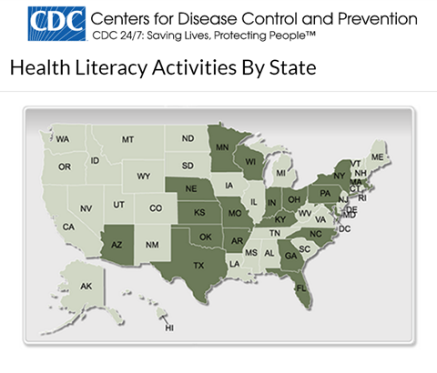
#1. The impacts of health literacy are not widely known…IS CHANGING
18 states with health literacy initiatives is better than none, but far from all 50…

Slide 23


#1. The impacts of health literacy are not widely known…IS CHANGING
Ontario Ministry of Health Booth
HealthAchieve Conference - Toronto
© 2018 MedEncentive, LLC. All Rights Reserved

Slide 24
#2. It seems too simplistic
Everyone knows that they should exercise more and eat better – right?
Limited health literacy examples:
Patient quits taking a medicine because they feel fine
Patient quits taking a medicine because they cannot tolerate it
Coffee is good for you, no wait, it’s bad for you
© 2018 MedEncentive, LLC. All Rights Reserved

Slide 25

#3. It is not in the best interest of key stakeholders
Industry slow to improve patient health literacy
By Steven Ross Johnson | November 3, 2018
“Movement as a country toward improving health literacy has been slow,” said Michael Abrams, managing partner at healthcare consulting firm Numerof & Associates. “The lack of a centralized effort on the part of the federal government to address low health literacy is somewhat surprising given that HHS recognized it as a major problem back in 2010 when it released a National Action Plan.”
“When hospitals were being paid to fix their mistakes, the lack of health literacy was a profit generator,” said Michael Abrams, managing partner at healthcare consulting firm Numerof & Associates. “Hospitals did not, by and large, own the issue.”

Slide 26
#4. No viable solutions
The health literacy solutions’ “state of the art” according to advocacy groups, CMS, CDC, IOM and NIH:
Doctors should talk more slowly and use smaller words
Doctors should practice the “speak-back” method (repeat after me)
Doctors should be taught (learn) how to be better communicators and educators
Write patient instructions in plain language

Slide 27
Clinic setting not conducive to promoting health literacy
A battery of studies have determined:
Doctors interrupt patients within the first 23 seconds
15% of patients fully understand their doctor
50% of patients comply with doctors’ orders
Causes misdiagnosis, inferior clinical outcomes, malpractice, and higher costs

Slide 28
Patient and Doctor Aligned Incentives
Another important concept that is important to improve health literacy

Slide 29
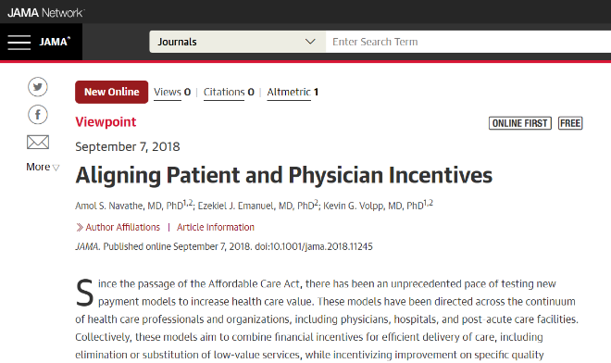
JAMA article by noted UPenn researchers
Zeke Emanuel, MD, PhD, Kevin Volpp, MD, PhD, and Amol Navathe, MD, PhD call for patient-physician aligned incentives

Slide 30

Study confirms aligned patient-physician incentives are most effective…
Effect of Financial Incentives to Physicians, Patients, or Both on Lipid Levels: A Randomized Clinical Trial.
Asch D, et al
https://www.ncbi.nlm.nih.gov/pubmed/26547464
Statin use and LDL reduction were superior when doctor/patient aligned incentives were employed versus incentives offered to patients and physicians, separately.
Aligned patient and physician incentives are more effective at producing superior outcomes

Slide 31
Health Literacy: The Sleeping Giant of Health Improvement and Cost Containment
Designing and Testing a Model to Improve Health Literacy

Slide 32
Health literacy, the knowledge-empowerment-motivation-adherence response and information therapy
When people know the “how” and “why,” and are “entrusted” to care for themselves, they are more empowered and motivated to comply with recommended treatments and adopt healthy behaviors.
Behavioral science describes this as the:
Knowledge-Empowerment-Motivation-Adherence (KEMA) Response
© 2018 MedEncentive, LLC. All Rights Reserved

Slide 33
Health literacy, the knowledge-adherence response and information therapy
How to achieve the knowledge-adherence (KEMA) response: doctors treat their patient’s low medical literacy by prescribing information therapy (homework):
the right information at the right time, in the right form so patients can make an informed decision.
Information Therapy
Symbolized by I_{x}®
© 2018 MedEncentive, LLC. All Rights Reserved
Notes:
Why my doctor: because I trust my doctor…

Slide 34
How do we motivate someone to act on the information they learned?
The Hawthorne effect is a psychological phenomenon that produces an improvement in human behavior or performance as a result of increased attention from superiors or persons in positions of authority and trust.
In all cases, observed individuals behave or perform better than unsupervised individuals for a limited time if they suspect or know about the observation.

Slide 35

Confirming the Hawthorne effect in the doctor-patient relationship
Doctor-Patient Relationship Influences Patient Engagement
Release Date: November 29, 2011 | By Valerie DeBenedette, Contributing Writer
Research Source: Center for Advancing Health
Researchers asked 8,140 people in the U.S. with chronic illnesses about their experiences with their physicians, as well as about their socioeconomic status, overall health and how they make use of health services.
Patients who perceived their physicians were involved in their care were more likely to monitor their blood pressure, exercise five days a week and adhere to medication regimens, among other healthy behaviors.

Slide 36
How do we motivate someone to act on the information they learned?
Promising-keeping: the act of doctors and patients declaring their compliance to treatment guidelines, then agreeing to allow the other party to have access to their declarations. In effect, this process involves creating an obligation to oneself and to someone each party respects (doctor to patient, and patient to doctor).
Guilt aversion: the desire to avoid taking actions that let down oneself or another person’s expectations.

Slide 37
Improving health literacy to achieve the
Ultimate Objective
Basic design elements of the model:
Compensate doctors to improve patients low health literacy during or after each office visit.
Reward patients for reading the information, passing a test, and reporting their level of adherence to their doctor
© 2018 MedEncentive, LLC. All Rights Reserved

Slide 38
Why use the doctor – patient relationship
Do patients trust their employer who hires a health coach to help them manage their health?
Do patients trust the insurer who have nurses calling to help them manage their health?
Do patients trust their doctor?
What if the patient had to report back to their doctor how they were doing with self-management?
© 2018 MedEncentive, LLC. All Rights Reserved

Slide 39
Health Literacy: The Sleeping Giant of Health Improvement and Cost Containment
The Patient Role

Slide 40
How do we nudge patients to learn and act
Give them a financial incentive to read information about their diagnosis
Have them pass a test to demonstrate they understand
Have them declare their level of adherence: somewhat, not really…
Have them report back to their doctor how they were doing with self-management
Rate the physicians recommendations to what they just read
© 2018 MedEncentive, LLC. All Rights Reserved

Slide 41
Testing to learn how well the method achieves the Ultimate Objective
Initial Results and Industry Validation

Slide 42

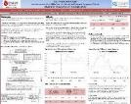
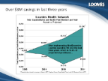
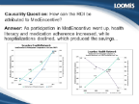
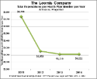
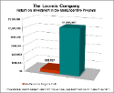
Independent confirmation of method’s effectiveness
  The Oklahoma Trial - Over 4 years, the City of Duncan:
  Realized a savings of between $3.1 and $17.7 for each $1 invested in the MedEncentive Program.
  The Kansas Trial - In 2½ years at the Wichita Clinic:
  Office visits increased 13%
  Medication adherence reported at 94%
  Hospitalizations decreased 55%
  The Washington Trial - Over 3 years at Lourdes Health System:
  Medication consumption increased
  Hospitalizations decreased
  12:1 ROI
  The Pennsylvania Trial – Over 3 years at the Loomis Company:
  Medication consumption increased
  Hospitalizations decreased
  15:1 ROI
© 2018 MedEncentive, LLC. All Rights Reserved

Slide 43

Industry Validation
Three stop loss companies have reviewed the independent studies and offer special discounts to an employer for adding this program
Sun Life
AIG
IHC Risk Solutions (Swiss Re)
© 2018 MedEncentive, LLC. All Rights Reserved

Slide 44

A large scale test with the State of Oklahoma’s self-funded multiple employer plan

Slide 45
Background:
Oklahoma legislators, interested in lowering healthcare cost, drafted legislation to test the program in 2011.
The statute (HB1062) passed by the Oklahoma Senate 46-0 and the House 86-9
The statute called for a 3-year pilot to test the cost containment capabilities of a “mutual accountability program” in Oklahoma public employee health plan (HealthChoice)
The pilot launched on January 1, 2014, and concluded on December 31, 2016
The largest Triple/Quadruple Aim experiment in the U.S.

Slide 46
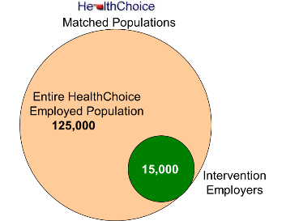
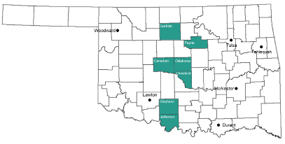


The Oklahoma pilot experimental design…
A randomized controlled trial (RCT)
Identify a subset of the full group to receive the “intervention” or method
  The subset should be a match of the full group: age, gender, social economic and risk factors
The intervention or covered group was comprised of 41 state agencies, school districts and local governments, concentrated in 7 counties – about 17,000 lives
Compare the two groups year over year trends to determine outcomes
© 2018 MedEncentive, LLC. All Rights Reserved

Slide 47
Metric that predicts success…
Patient Engagement
The strongest determinant of a return on investment is the Patient Success Rate¹, which is a measure of patient engagement
In previous trials, a Patient Success Rate of 55% or greater produced a ROI in each instance
¹ Patient Success Rate = the total number of information therapy sessions ÷ the total number of office visits incurred by the covered population
© 2018 MedEncentive, LLC. All Rights Reserved

Slide 48
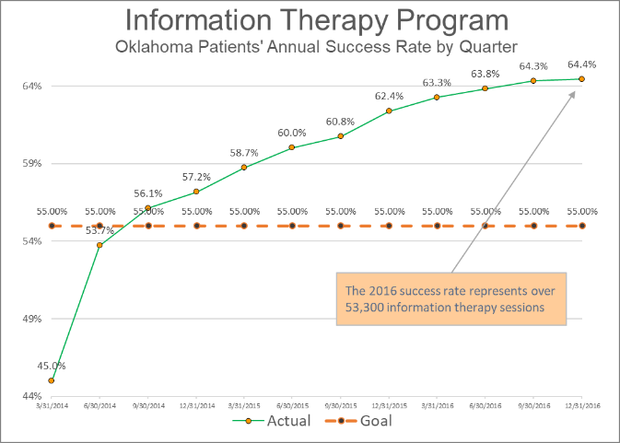
Patient success rate far exceeded the 55% goal
© 2018 MedEncentive, LLC. All Rights Reserved

Slide 49
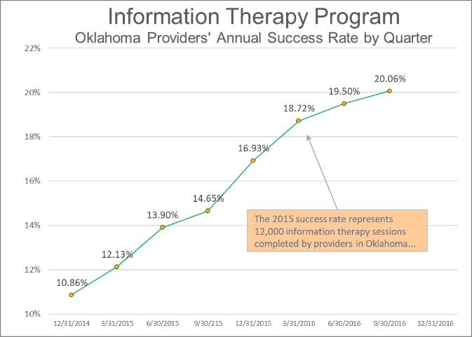
Provider successes started at a level adequate to achieve the pilot’s ROI goal, and then doubled…
© 2018 MedEncentive, LLC. All Rights Reserved

Slide 50
Health Literacy: The Sleeping Giant of Health Improvement and Cost Containment
Pilot Clinical and Economic Outcomes

Slide 51
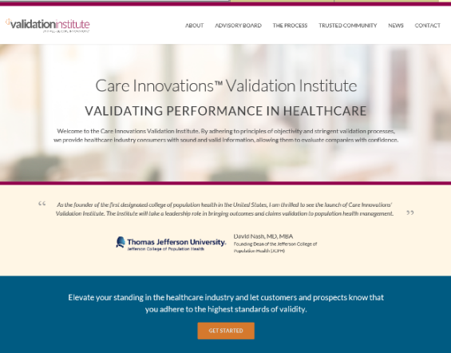
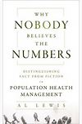
The Validation Institute was consulted to confirm the methods for measuring the outcomes
Not-for-profit joint venture of GE and Intel
Formed to establish truth in population health claims after Al Lewis, who wrote a book, entitled: “Why Nobody Believes the Numbers,” about vendors claiming false and misleading results in the field of healthcare cost containment
Board is comprised of the leading experts in the field of population health, who set forth rules to test the accuracy of claims by anyone in the field
© 2018 MedEncentive, LLC. All Rights Reserved

Slide 52
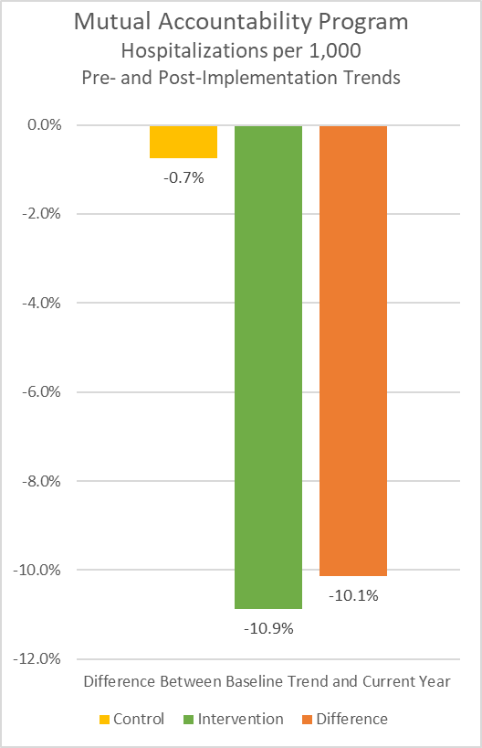
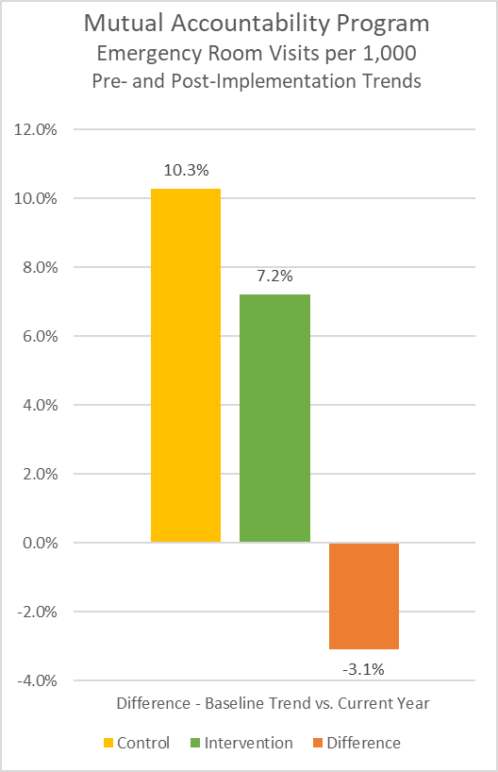
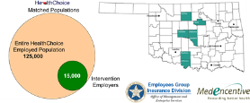
State of Oklahoma Pilot Results
Group covered by the program demonstrated a 10.1% and 3.1% greater decline in hospitalizations and emergency room visits per 1,000 per annum compared to the control group
© 2019 MedEncentive, LLC. All Rights Reserved

Slide 53
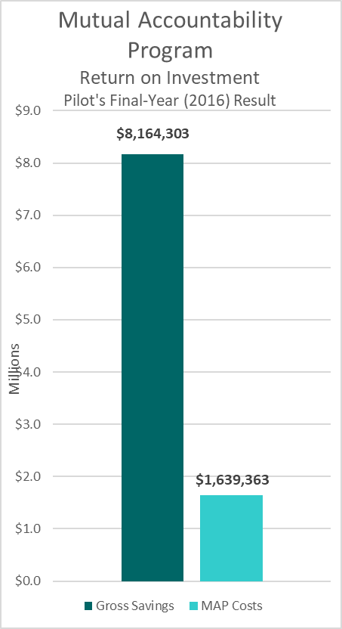
State of Oklahoma Pilot 2014-16 Preliminary Results
(pending data access to test for confidence interval and attribution)
Group covered by program experienced 6% decline in total PMPY costs compared to the control group, translating to a 398.0% return on investment
Net savings equate to a 398.0% or a (4:1) ROI
© 2019 MedEncentive, LLC. All Rights Reserved

Slide 54

Additional Test To Confirm Outcomes
2015-17 Results
Corroborating and Projecting the State Pilot’s Outcomes

Slide 55

Located in Payne County, the Stillwater Medical Center’s installation ran concurrent with the State of Oklahoma pilot
© 2018 MedEncentive, LLC. All Rights Reserved

Slide 56
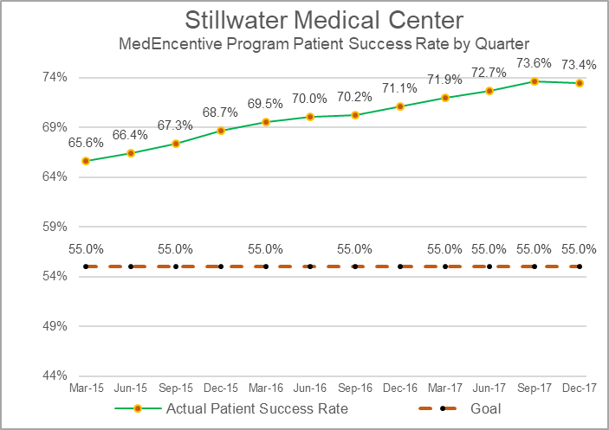
Stillwater Medical Center
Patient engagement went well above 55%
© 2018 MedEncentive, LLC. All Rights Reserved

Slide 57
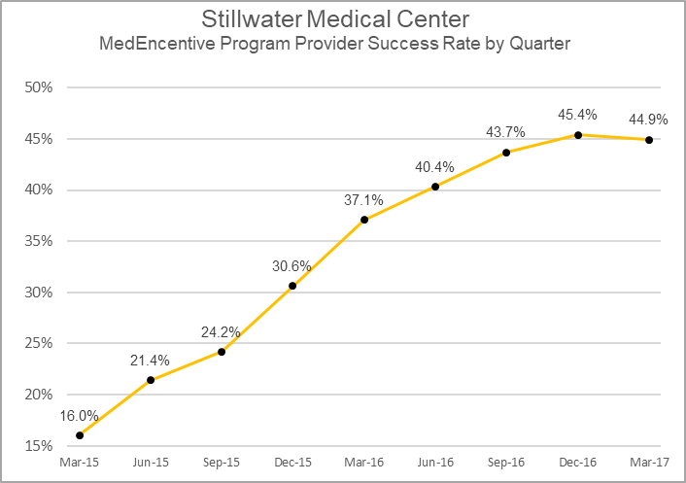
Stillwater Medical Center
Provider engagement was excellent due to SMC’s leadership
© 2018 MedEncentive, LLC. All Rights Reserved

Slide 58
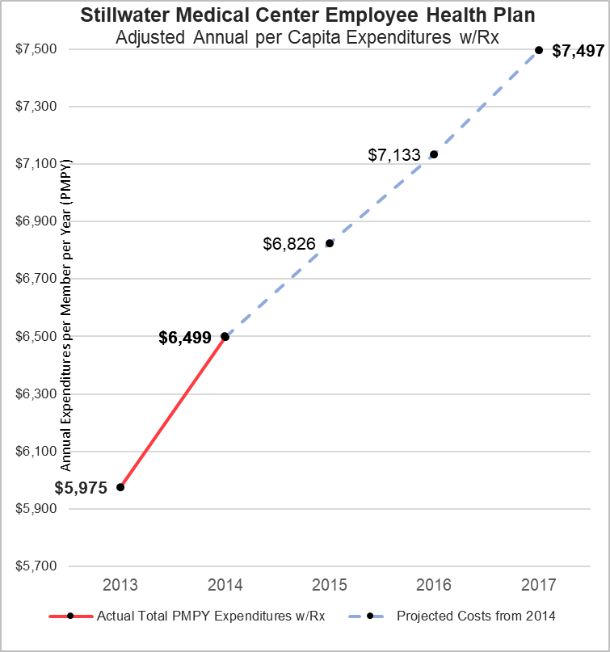
Stillwater Medical Center
(with 2,000+ lives)
Three-Year Results with the Method Against Nat’l Trend
Prior to implementing program
Projected trend based on national indices¹ was consistent with SMC’s trend
Actual results for 2013 and 2014 established a trend
¹ Projected trend based on average of applicable Kaiser Family Foundation, Segal, and Nat'l Health Expenditure Accounts Indices
© 2019 MedEncentive, LLC. All Rights Reserved

Slide 59
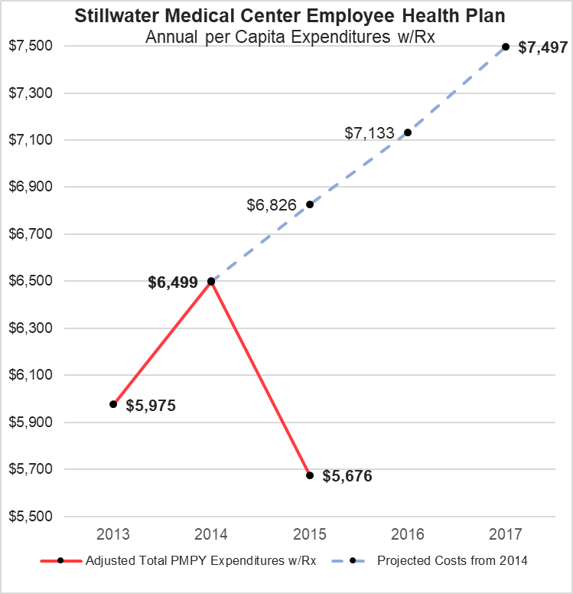
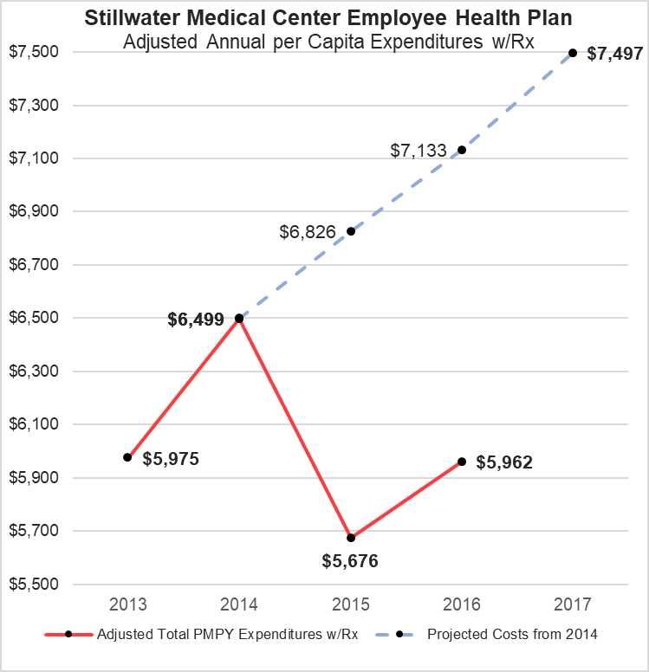
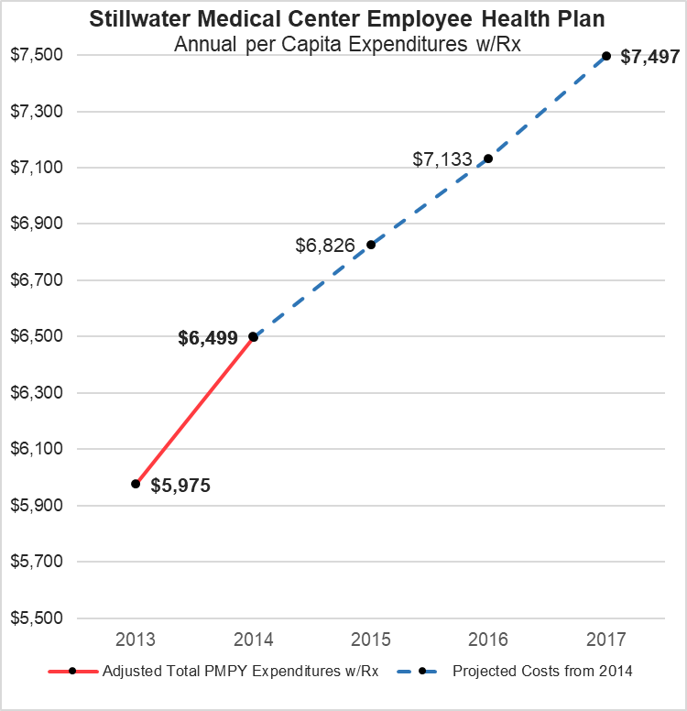
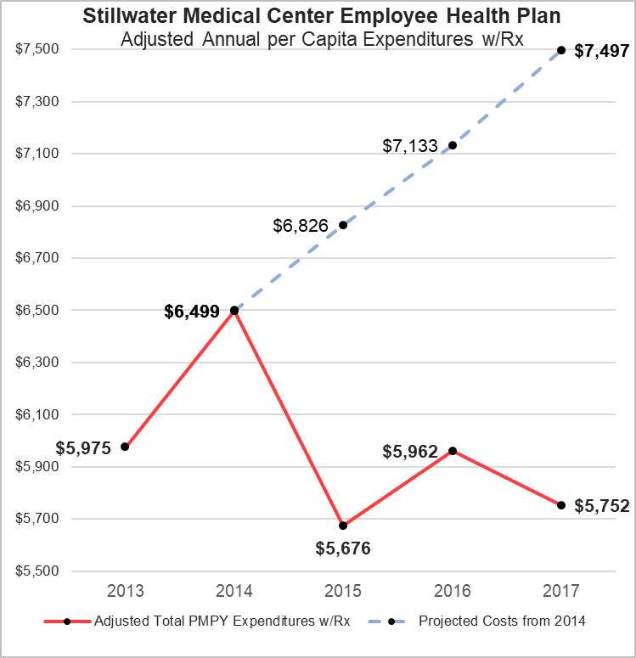
Stillwater Medical Center
(with 2.000+ lives)
Three-Year Results with the Method Against Nat’l Trend
Prior to implementing program
Expenditures include the cost of Program
Projected trend based on average of applicable Kaiser Family Foundation, Segal, and Nat'l Health Expenditure Accounts Indices
2016-17 are adjusted for inpatient and outpatient hospital price increases and outpatient utilization
© 2019 MedEncentive, LLC. All Rights Reserved

Slide 60
What happened in 2016?
SMC started a Comprehensive Primary Care (CPC) pilot with Medicare
Every patient is part of the pilot
Comprehensive means that they do lots of tests and exams
Causes a spike in utilization: labs, x-rays, etc.

Slide 61
Stillwater Medical Center
(with 2.000+ lives)
Three-Year Results with the Method Against Nat’l Trend
Prior to implementing program
To test attribution, health literacy studies indicate hospitalizations and emergency room rates should corroborate the results
Expenditures include the cost of Program
Projected trend based on average of applicable Kaiser Family Foundation, Segal, and Nat'l Health Expenditure Accounts Indices
2016-17 are adjusted for inpatient and outpatient hospital price increases and outpatient utilization
© 2019 MedEncentive, LLC. All Rights Reserved

Slide 62
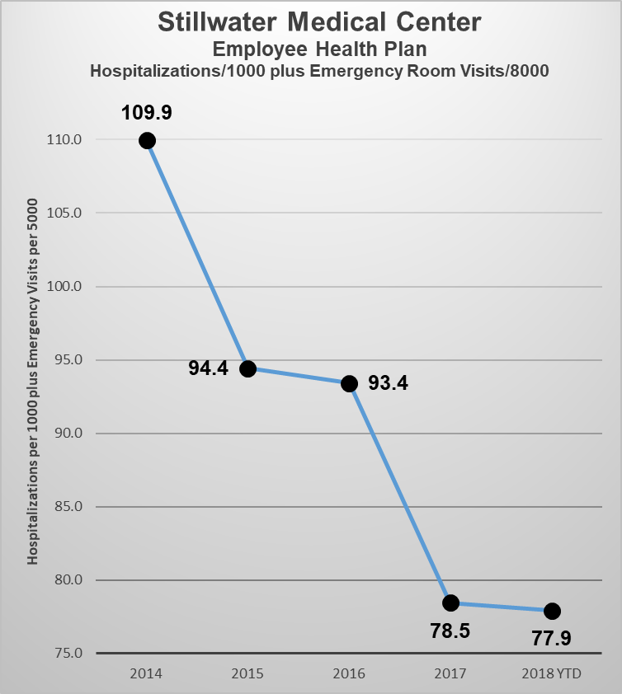
Stillwater Medical Center
(with 2,000 + lives)
SMC’s reduced costs can be attributed to reductions in hospitalizations and ER visits
29.1% decrease in hospitalizations and emergency room visits after the program was implemented
Prior to implementing MedEncentive MAIT Program
© 2019 MedEncentive, LLC. All Rights Reserved

Slide 63

Stillwater Medical Center
(with 2.000+ lives)
Three-Year Results with the Method Against Nat’l Trend
Prior to implementing program
Projected trend based on average of applicable Kaiser Family Foundation, Segal, and Nat'l Health Expenditure Accounts Indices
2016-17 are adjusted for inpatient and outpatient hospital price increases and outpatient utilization
© 2019 MedEncentive, LLC. All Rights Reserved

Slide 64
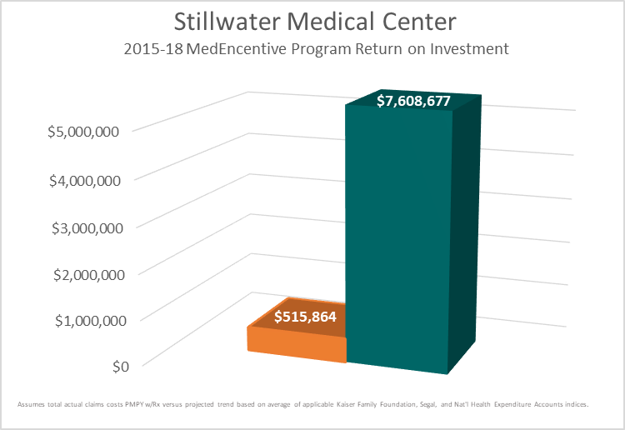
Stillwater Medical Center
(with 2,000+ lives)
Three-Year ROI Results with the Method Against Nat’l Trend
Represents a 15:1 ROI
over a 3-year period
Net savings associated with the Program¹
Cost of the Program including rewards
Projected trend based on average of applicable Kaiser Family Foundation, Segal, and Nat'l Health Expenditure Accounts Indices
2016-17 are adjusted for inpatient and outpatient hospital price increases and outpatient utilization
© 2019 MedEncentive, LLC. All Rights Reserved

Slide 65
Health Literacy: The Sleeping Giant of Health Improvement and Cost Containment
What about patient and provider satisfaction?

Slide 66
Thousands upon thousands of voluntary patient testimonials...
“This is great! I like the information and getting paid to take better care of myself is the BEST idea ever!”
Elayne
April 24, 2018
"This is an excellent motivator to learn and refresh memory. As a nurse (and an older nurse as well), I appreciate the information updates especially considering how technology has advanced and improved medical care.."
Janice
May 2, 2018
"This is a very informative and educational program and it offers an insightful benefit to patients to understand their physical health along with other health resources . After reading the articles; I always learn more about my physical health and I am better prepared to ask the appropriate questions to my doctor concerning my health.“
Paul
October 2018
© 2018 MedEncentive, LLC. All Rights Reserved

Slide 67


What employers say…
In 2018, Stillwater Medical Center was named by Modern Healthcare number 16 in its prestigious Top 100 Best Places to Work in American Healthcare.
“This accomplishment was due in large part to the MedEncentive Program!”
Keith Hufnagel
VP Human Resources
Stillwater Medical Center
Stillwater, Oklahoma
© 2018 MedEncentive, LLC. All Rights Reserved

Slide 68
What physician leaders say...
“This is a unique tool to improve a critical component of health care - patient compliance”
Steve Connery, M.D.
Family Physician
President of the Norman Physician Hospital Organization
Norman, Oklahoma
“I have found the program useful in increasing patient engagement, and think ultimately will lead to better health outcomes. It is user friendly and minimally disruptive to my normal workflow.”
Jesse R. Campbell, M.D.
Internal Medicine, Pediatrics
Medical Director, Mercy Physician Group
Edmond, Oklahoma
© 2018 MedEncentive, LLC. All Rights Reserved

Slide 69
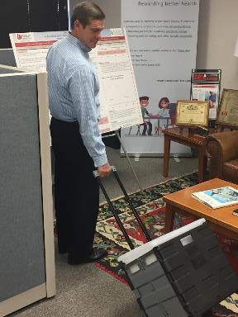
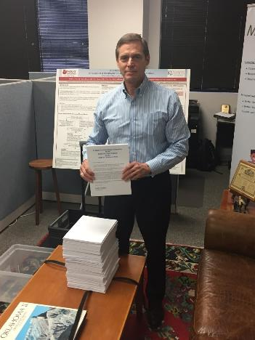

Program is extremely popular – thousands of petitions from state employees and teachers seeking a continuation of the pilot…
© 2018 MedEncentive, LLC. All Rights Reserved

Slide 70


Pending Publications
A study with multiple trials and a position paper are being prepared for publication in peer-reviewed journals by top researchers.
      Jolie Haun, PhD, EdS – Veterans Affairs researcher, principal investigator of the seminal study on the association of health literacy to medical costs.
      Dustin French, PhD – Northwestern University, Associate Professor, Feinberg School of Medicine

Slide 71
Summary
Health literacy is an important aspect of better health and lower costs
Aligning provider and patient incentives improves health and lowers cost
Information therapy empowers and motivates patients to improve their health
Patient’s reporting their health activities to their doctor motivates health improvement
Teaching people how to fish and recognizing their effort produces better, sustainable and more efficient results

Slide 72
Q&A
Health Literacy: The Sleeping Giant of Health Improvement and Cost Containment
Contact:
jdempster@medencentive.com
405-319-8454

