Slide 1
Employee Assistance Program
Terry Stover MS, CEAP, LBP, MAC, NCP, CCJS, SAP
Senior Manger, CommunityCare EAP

Slide 2


Stress Management

Slide 3
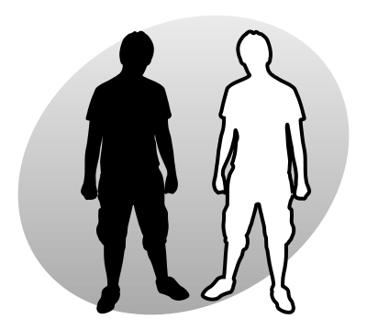
What is Stress?
Stress can be defined as our mental, physical, emotional, and behavioral reactions to any perceived demands or threats.

Slide 4

What Makes Something Stressful?
Situations that have strong demands
Situations that are imminent
Life transitions
Timing (e.g., deviation from the “norm”)
Uncertainty
Desirability
Controllability
Notes:
Ambiguous situations are those that we are unsure of, and can cause stress because of something that is new to us (for example, you may be stressed when taking an exam with a professor for the first time, because you are not sure what to expect). Desirable situations are stressful because our performance in these situations may influence our ability to get something we really want (for example, you may be really stressed in a job interview for the job of your dreams). We also tend to get stressed out in situations that we do not have a lot of control over.

Slide 5
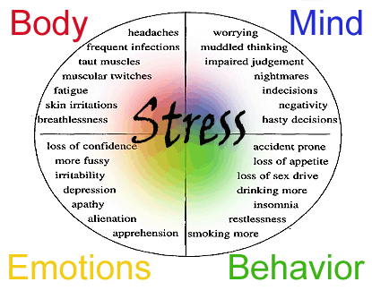
Stress Connected

Slide 6
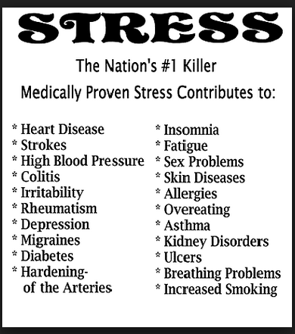
# 1 Killer in the Untied States

Slide 7
Where Do You Rank On Stress?
On the Worst Jobs List Worldwide, you rank 155th out of top 200. (BCS Insurance Company)
Stress is the number one reason you leave your industry. (Ecclesiastical study)
Ranked 6th overall most stressful jobs in the US excluding emergency response/frontline medical. (USA Today)
Cross-sectional review indicated HR ranked 1# in stress followed by at Brokers #6. (Open Business Council)

Slide 8
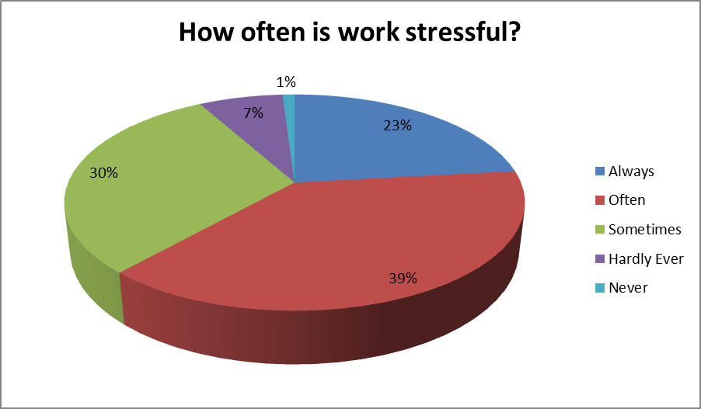
Employee Support Personnel Stress Level

Slide 9
Not All Stress is Bad…
Stressor – environmental conditions that cause individuals to experience stress
Eustress is the other form of stress that is positive and beneficial. We may feel challenged, but the sources of the stress are opportunities that are meaningful to us. Eustress helps provide us with energy and motivation to meet our responsibilities and achieve our goals.
  Examples of eustress include graduating from college, getting married, receiving a promotion, or changing jobs.
Distress is a continuous experience of feeling overwhelmed, oppressed, and behind in our responsibilities. It is the all-encompassing sense of being imposed upon by difficulties with no light at the end of the tunnel.
  Examples of distress include financial difficulties, conflicts in relationships, excessive obligations, managing a chronic illness, or experiencing a trauma.

Slide 10
Workplace Stress Defined
Stress
Job Stress
Acute
Chronic
Notes:
Stress – a feeling of tension that occurs when a person assesses that a given situation is about to exceed his or her ability to cope and consequently will endanger his or her well-being.
Job stress - the feeling that one’s capabilities, resources, or needs do not match the demands of the job.
Acute stress – a short-term stress reaction to an immediate threat
Chronic stress – a long-term stress reaction resulting from ongoing situations

Slide 11
Uneasiness
and Worry
Feelings of
Sadness
Loss of
Appetite
Increase in
Energy
Immune System
Suppression
Acute
Alertness and
Excitement
Increased
Metabolism
Loss of
Sex Drive
Chronic
Anxiety and
Panic Attacks
High Blood
Pressure
Irritability
Depression
Diabetes
Lowered
Resistance
Eating
Disturbances

Slide 12
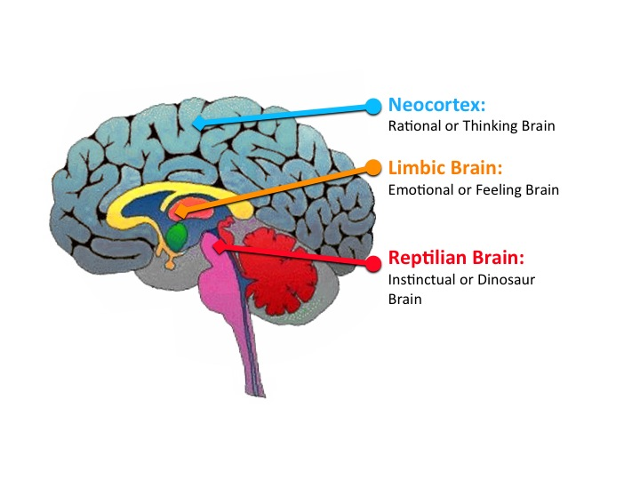
Three Brains and
Your Stress
The Lizard Brain we will call the lower Old Brain controls automatic function.
The Limbic “Amy” Brain we call the upper Old Brain facilitates memory storage and retrieval, establish emotional states, feelings & emotions.
The Neocortex “Wizard Brain” is the rational/thinking brain symbolized in language, pictures, it makes choices, is conscious and self-aware.

Slide 13
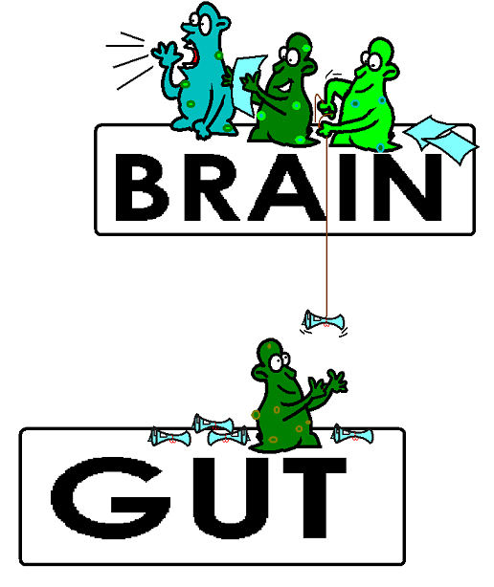
The Brain in
Our Gut!
Our 4th brain is in our gut.
Mental Health is not all in our head, our diet can paly a large role in what we feel/think. It is made up of more than 200 to 600 million neurons arranged in the intricately folded tissues that line the intestinal tract to the other three brains.

Slide 14

Smoke Alarm
Think of your old brain
like a smoke detector. It
doesn’t know the difference between a
real fire or a burnt piece of toast. All it
wants to do is keep you safe. It makes enough noise to get a response.

Slide 15
The Old Brain
What It Does Why It Does It
Sends electrical impulses Prepares your body for fight or flight
Changes the depth and Increases the level of
rate of breathing oxygen
Increases HR and BP Moves oxygen to vital organs and muscles
Stops digestion No wasted energy
Tightens muscles Increases strength to armor the body
Dilates eyes Improves eyesight
Shifts thinking From logical to instinctual

Slide 16
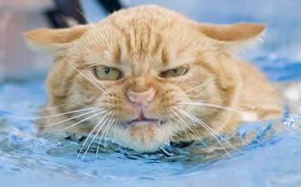
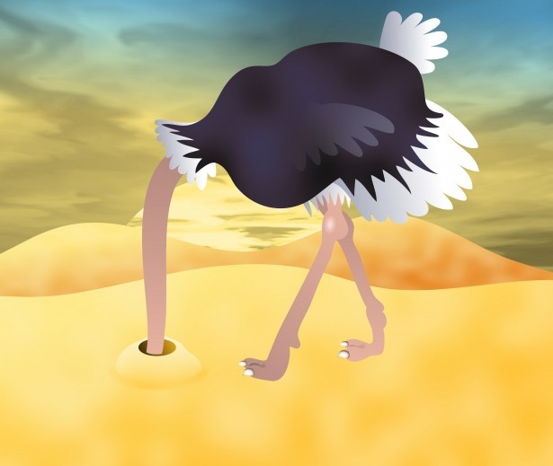

Four Main Reactions to Stress/Trauma
Anger (Fight), Freeze (dissociation), Fear (Flight)
Fawn (Invisible )

Slide 17
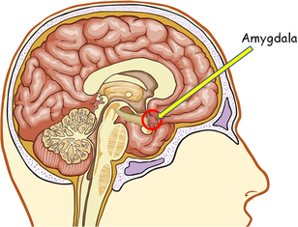
Junction Box between the Lizard and Wizard Brains is the Mid Brain
Amygdala “Amy”

Slide 18

Computer Brain
“Here and Now….Awwww Pretty ”

Slide 19
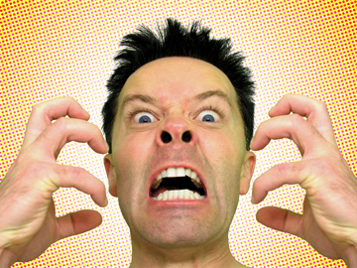
Maladaptive Coping Skills
Drinking/drugs Overeating
Oversleeping Isolating
Taking your stress out on others
Zoning out for hours (TV and computer)
Notes:
Others?

Slide 20
The “Basic 4” of Stress Busting for the Biochemistry
OWN your body
1st is O = Oxygen
2nd is W = WATER
3rd is N = Nutrition
4th is Good Sleep Hygiene

Slide 21
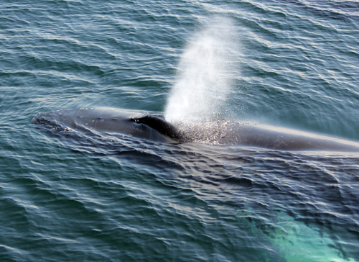
1st Oxygen
Breathing
Alternate Nostril Breathing
Belly Breathing
Deep Breathing

Slide 22

2nd Water
Dehydration will cause the old brain to increase stress chemicals to keep you alive. It doesn’t know you have plenty of water available. It thinks you are in a drought!
The Old Brain likes water to be taken in frequently throughout the day.

Slide 23

3rd Nutrition
The same holds true for food. If you are not eating throughout the day, the old brain will increase your stress levels. It thinks you are in a famine!
The old brain reacts negatively to stimulants like caffeine and sugar. It likes healthful meals 3 – 4 times a day.

Slide 24
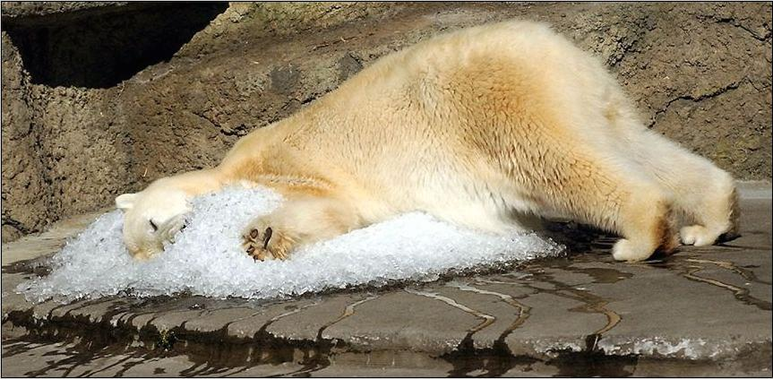
4th is Sleep
Your body needs sleep to maintain itself properly.
  Sleep time is when our cells regenerate and “clean out” the day’s toxins.
  The immune system is more active at night.
  REM (deep) sleep is when blood pressure is the lowest, thereby giving the heart a needed rest.
  Lack of sleep is known to be a “trigger” for many mental and physical illnesses.
  The old brain needs 7 – 8 hours per night.

Slide 25
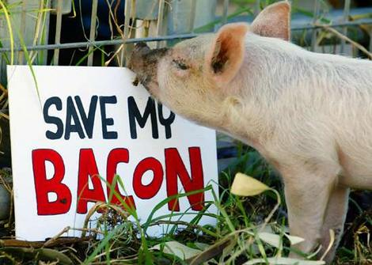
17 De-Stressing Suggestions

Slide 26
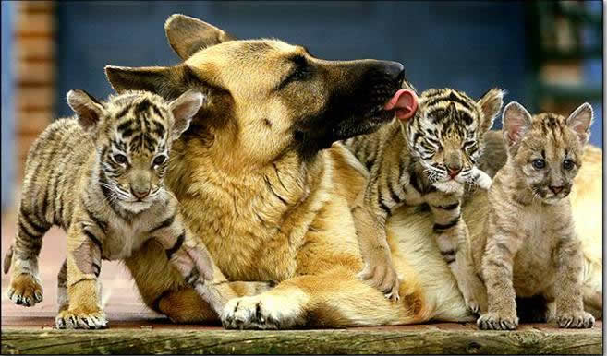
Suggestions for Reducing Stress
1. Find a support system. Find someone to talk to about your feelings and experiences.
Notes:
Speak to friends, family, a teacher, a minister, or a counselor. Sometimes we just need to "vent" or get something "off our chest." Expressing our feelings can be relieving, we can feel supported by others, and it can help us work out our problems.

Slide 27
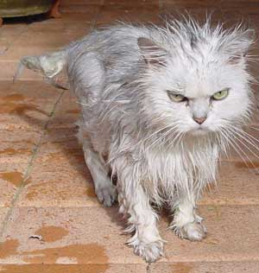
Suggestions for Reducing Stress
2. Change your attitude. Find other ways to think about stressful situations.
  "Life is 10% what happens to us, and 90% how we react to it."
Notes:
Talk to yourself positively. Remember, "I can handle it, " "this will be over soon," or "I have handled difficult things before, and I can do it again." Also, practice acceptance. We need to learn to accept things we cannot change without trying to exert more control over them.

Slide 28
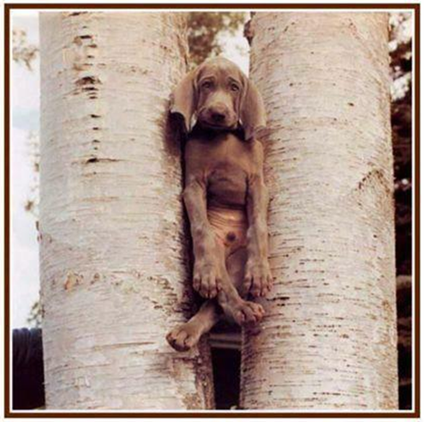
Suggestions for Reducing Stress
3. Be realistic. Set practical goals for dealing with situations and solving problems.
  Develop realistic expectations of yourself and others.

Slide 29
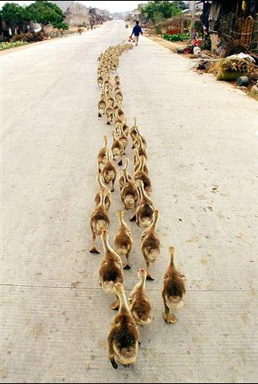
Suggestions for Reducing Stress
4. Get organized and take charge. Being unorganized or engaging in poor planning often leads to frustration or crisis situations, which most always leads to feeling stressed.
  Plan your time, make a schedule, establish your priorities.

Slide 30
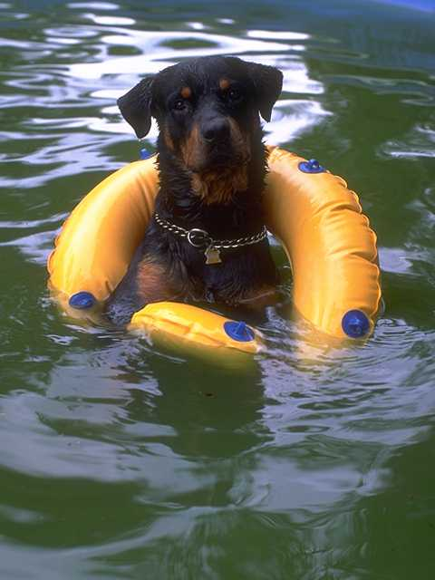
Suggestions for Reducing Stress
5. Take breaks, give yourself "me time." Learn that taking time to yourself for rejuvenation and relaxation is just as important as giving time to other activities.
  At minimum, take short breaks during your busy day.
Notes:
You might purposely schedule time in your day planner just for yourself so that you can recharge for all the other things you need to do. Learn your "red flags" for stress, and be willing to take time to do something about it.

Slide 31

Suggestions for Reducing Stress
6. Take good care of yourself. Eat properly, get regular rest, keep a routine. Allow yourself to do something you enjoy each day.
  Paradoxically, the time we need to take care of ourselves the most, when we are stressed, is the time we do it the least.
Notes:
When we feel overwhelmed we tend to eat poorly, sleep less, stop exercising, and generally push ourselves harder. This can tax the immune system and cause us to become ill more easily. If we take good care of ourselves to begin with, we will be better prepared to manage stress and accomplish our tasks in the long run.

Slide 32
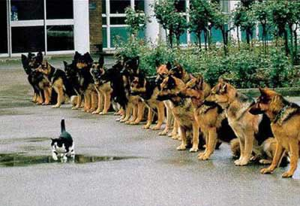
Suggestions for Reducing Stress
7. Learn to say "no." Learn to pick and choose which things you will say "yes" to and which things you will not.
  Protect yourself by not allowing yourself to take on every request or opportunity that comes your way.

Slide 33
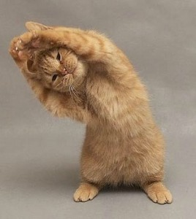
Suggestions for Reducing Stress
8. Get regular exercise. Exercising regularly can help relieve some symptoms of depression and stress, and help us to maintain our health.

Slide 34
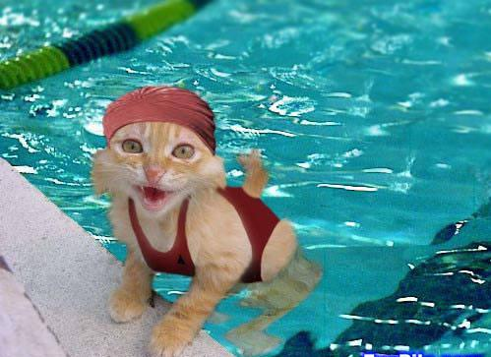
Suggestions for Reducing Stress
9. Get a hobby, do something different. For a balanced lifestyle, play is as important as work.

Slide 35

Suggestions for Reducing Stress
10. Slow down. Know your limits and cut down on the number of things you try to do each day, particularly if you do not have enough time for them or for yourself.
  Be realistic about what you can accomplish effectively each day.
  Monitor your pace. Rushing through things can lead to mistakes or poor performance. Take the time you need to do a good job.
    Poorly done tasks can lead to added stress.

Slide 36
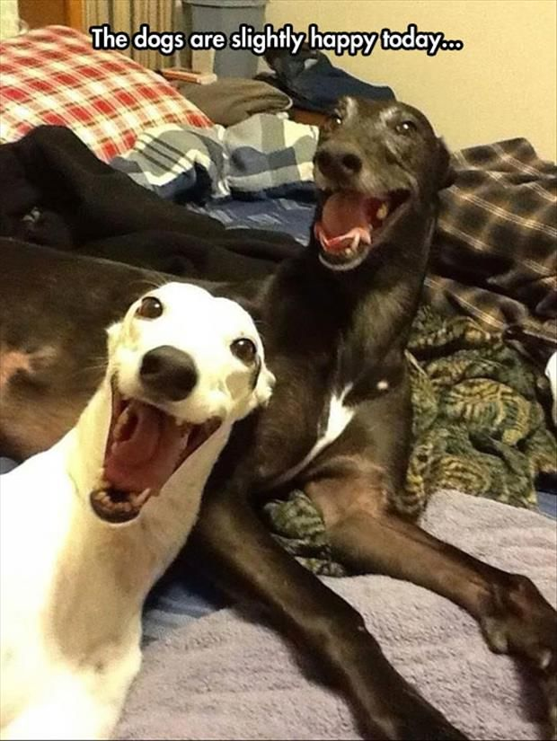
Suggestions for Reducing Stress
11. Laugh, use humor. Do something fun and enjoyable such as seeing a funny movie, laughing with friends, reading a humorous book, or going to a comedy show.

Slide 37

Suggestions for Reducing Stress
12. Learn to relax. Develop a regular relaxation routine.
  Try yoga, meditation, or some simple quiet time.
Notes:
Relaxation techniques are skills that need to be developed with patience and practice so that we can use them effectively during difficult times of stress later on.

Slide 38
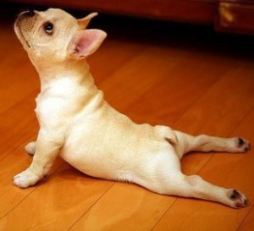
Suggestions for Reducing Stress
13. Relaxation Exercises
Many different kinds, but some are:
  Deep Breathing
  Visualization: Visualization is a nice way of giving our minds and bodies a "mini vacation.“
  Muscle Relaxation
Notes:
When we feel stressed, it is common for our rate of breathing to increase. We also tend to breath in a shallow manner, more highly in our chest. A deep breathing exercise allows us to take fuller, slower breaths that reflect a true relaxed state
It involves using imagery to fully immerse ourselves in a pleasant scene, noticing the sights, sounds, smells, and tactile sensations.

Slide 39
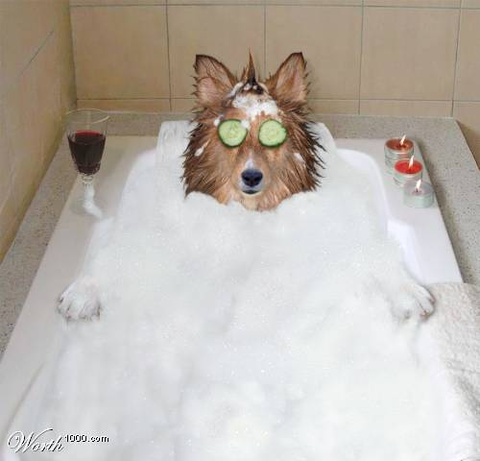
Suggestions for Reducing Stress
14. Heat Therapy
Hot soak in a tub
Heating Pad
Hot Water Bottle
Warm cup of tea or cocoa
Warm PJ’s
Don’t forget to breathe deeply!

Slide 40

Suggestions for Reducing Stress
15. Medication

Slide 41


Suggestions for Reducing Stress
16. Financial
Live on a realistic budget
Spend less than you make
Be a smart shopper – do your homework – look for bargains
Eliminate and avoid debt
Save for emergencies
Save for the future
Invest for retirement
Learn to be content – simplify!

Slide 42
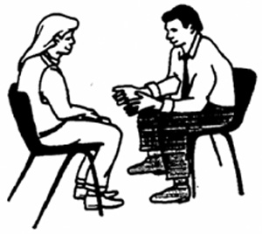
17. Counseling
EAP
Community Based
United Way
State Funded
Insurance
Cognitive Behavioral Therapy (CBT): can be helpful with the emotions, thoughts and behaviors of anxiety.
Suggestions for Reducing Stress

Slide 43
CommunityCare Employee Assistance Program Offers:
Free counseling/short term session models
An outside perspective on your situation
Ongoing feedback and support
Referrals and information on long term services or issues requiring specialization
Free service
Male and female counselors
24 hours assistance
Employees and dependents

Slide 44
CommunityCare EAP
All State Licensed Counselors
Located at Williams Tower II Two West 2nd Street
(100 W. Parking Garage Lot 129– Free Parking)
Call (918) 594-5232 or 1-800-221-3976

Slide 45
General rule of thumb
Make small changes, a little at a time This will improve your chances of making them permanent.
Personalize your plan!
Notes:
Small changes are usually the best changes to make. They are easier to maintain.

Slide 46
Questions?
Thank you for filling out the attached evaluation.
Notes:
There is an evaluation at the back of this packet. We appreciate any feedback about this program. Thank you for your attention.

