Slide 1


Self-Funding Fundamentals

Slide 2


Confidential Information
The following contains information related to the unique group purchasing approach of The Benecon Group. This consists of risk sharing models and mathematical formulas that Benecon considers proprietary intellectual property.
By reviewing this presentation, it is understood that the holder of this information shall keep all ideas and concepts in strict confidence.
Without the prior written consent of The Benecon Group, no one shall copy, reproduce or disclose in any manner any of the contents in this presentation to any third parties.
2024 The Benecon Group, LLC – All Rights Reserved

Slide 3
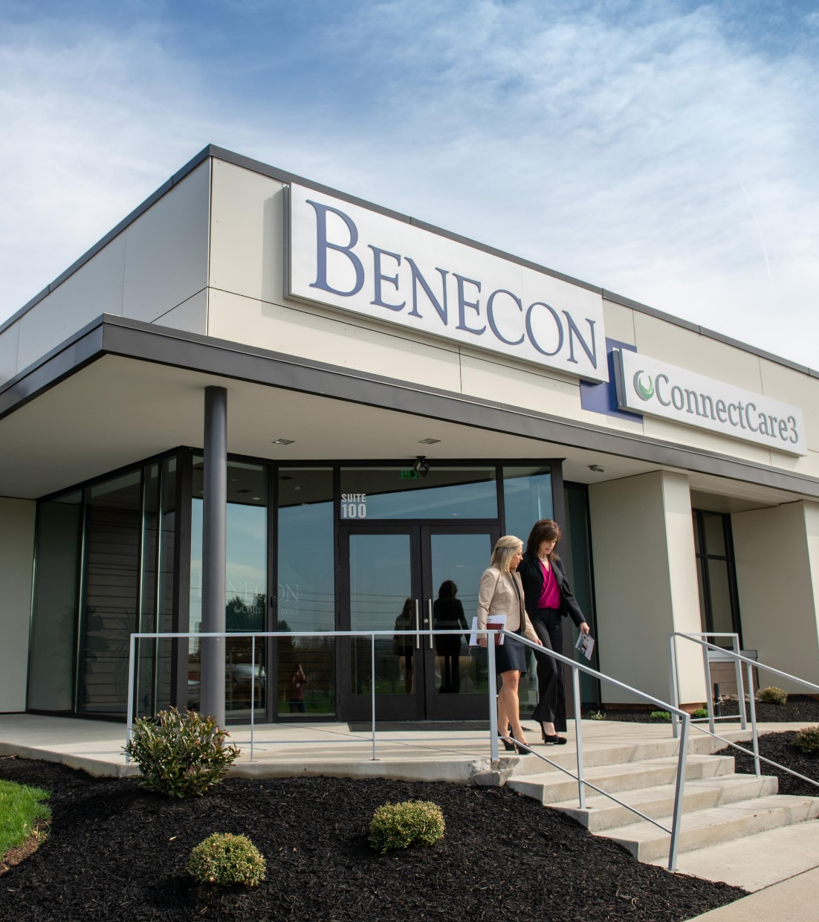
Agenda
How to build a Health Plan
History of Self Funding
“Why self-funding?”
  Advantages and pitfalls of self-insurance
Terms funding mechanisms
  Establish knowledge of key concepts like product specific, aggregate, contract types, stop loss trends, etc.
Vendor Selection
Market Trends

Slide 4
How to Build a Health Plan
Direct Networks
Provider Network
Admin
UM / CM
Chronic Care Management
Not all health Plans are the same!
Specialty RX Carve-out
Prescriptions

Slide 5


Not all Health Plans are the same…
Disney / Event
Home Refrigerator
$2.50 - $5.00
.80
While they all include the same or similar pieces, they key is “Who” owns / controls the pieces.

Slide 6
The Spectrum of Risk
Fully Insured | Refunding Plan | Level-Funding | ASO w/ SL | Pure ASO
6

Slide 7
Vendor Selection
“Knowledge is power”, both Francis Bacon and Thomas Jefferson
Practical Considerations:
Level of reporting
Easy of integration
Cost
Track Record (references)
Cultural Considerations:
Company Culture
Employee Geography
Attrition rate

Slide 8
ERISA
What is ERISA?
Employee Retirement Income Security Act of 1974
Formally recognizes self-funding and self-funded plans
Establishes exemption of certain insurance mandates, such as state-specific regulation, premium tax and some mandated benefits
What is Self-Funding?
Employer retains insurance risk instead of transferring to an insurance company
Employer most often hires TPA (or carrier) to administer plan
Most employers purchase catastrophic protection in the form of stop loss to mitigate against large, unknown loss
According to KFF – “64% of covered workers in a self-insured plan, including 21% in small companies (3-199) and 82% in large companies (200+)”
42% of small employers in level-funded arrangements

Slide 9
Why Self-Fund?
Employer Advantages
Control & Data
Group dictates benefits (within ERISA guidelines), allowing for full customization
Data – group has access to their own detailed claims data (de-identified) to understand root causes & trends
Surplus – no longer giving profit to medical carriers
Control – can create unique health offerings to suit the needs & demographics of the group’s population and only pay for what they need
Elimination or dramatic reduction of most premium taxes
Tax on full premium vs. stop loss premium
Cash Flow – pay claims as they occur, not pre-paying for claims or paying premiums for claims not incurred
Unbundling – Ability to tap into “best in class” vendors for each part of the benefits puzzle
Stability – Employer pays “known losses” and can purchase stop loss to protect against catastrophic losses

Slide 10
What goes into a stop loss proposal?
Fixed costs
  Individual Stop Loss premium
  Aggregate Stop Loss premium
  Administration fees
    TPA
    Network
    medical management
    etc.
Variable costs
  Claims Reserve - Expected claims
Total costs (fixed + variable)
  Expected vs Maximum

Slide 11
Stop Loss 101
Fixed Costs
Variable Costs
Notes:
Protects against large claims above the “specific limit” or “deductible”
*Only within the contract period
Covers both employees & dependents, reimbursing the employer not the employee
Laser
Carve out, or specific limit different than the group ISL for large, known risk
Higher deductible than group
Specific claims not factored into Aggregate Coverage
Aggregate Coverage: Protects the group from covered loss from aggregated claims over the policy period
Covers all claims over the Aggregate deductible or “corridor”
Common corridors from 10-25% above expected claims
ISL claims excluded
Typically covers Med/Rx only but can include Dental & Vision (uncommon)

Slide 12
 |  |  | Admin & PCORI* (9.8%), $103,910
Fixed Premium (Non-Refundable) $1,249,468 |  |  | Stop Loss (36.2%) $383,615
 |  |  |  |  | Claim Liability
 |  |  |  |  | ► Expected Claim Cost
 |  |  | Claim Fund (54.0%) (Expected + Corridor) $572,275 |  | ► Claim cost below Maximum Claim Liability → Surplus
No Surplus | 100% of Surplus Refunded
$1,249,468 |  |  | $1,059,800
Fully Insured vs Self Funded

Slide 13
Stop-Loss Contracts, continued
12/12 Contract
January 1st
December 31st
15/12 Contract (“Run-in”)
October 1st
January 1st
December 31st
12/15 Contract (“Run-out”)
January 1st
December 31st
March 31st
Notes:
Contract Terms
Incurred Period/Paid Period; expressed in months
12/12 – claims incurred and paid within a 12-month period
15/12 – includes claims incurred up to 3 months prior to the contract and paid within the 12-month contract period (run-in coverage)
12/15 – includes claim incurred within the 12-month contract period and paid up to 3 months after the end of the contract (run-out coverage)
Paid/12 – claims incurred from the moment of contract inception and paid within the 12-month contract period (maximum coverage, no coverage gaps, most expensive)

Slide 14
Stop-Loss Vendor Options
Typical stop loss insures
Investor backed stop loss
Alternative models
  Managing General Underwriter (MGU)
  Captive
  Consortium
Considerations for choosing
Financial Rating (AM Best)
Industry reputation
Claims payment timing
Product security – spec & agg accommodation

Slide 15
Looking Forward – Industry Trends
Volatility in small to mid-market renewals
Shift from “pooled” underwriting to experience underwriting
Significant increase in high-dollar claims, post ACA
Significant trend increase in Rx
  Gene therapies
Market Reactions
Reference based pricing (RBP) or Medicare-like rate repricing
Direct Contracts
Captive & Consortium stop loss models

Slide 16
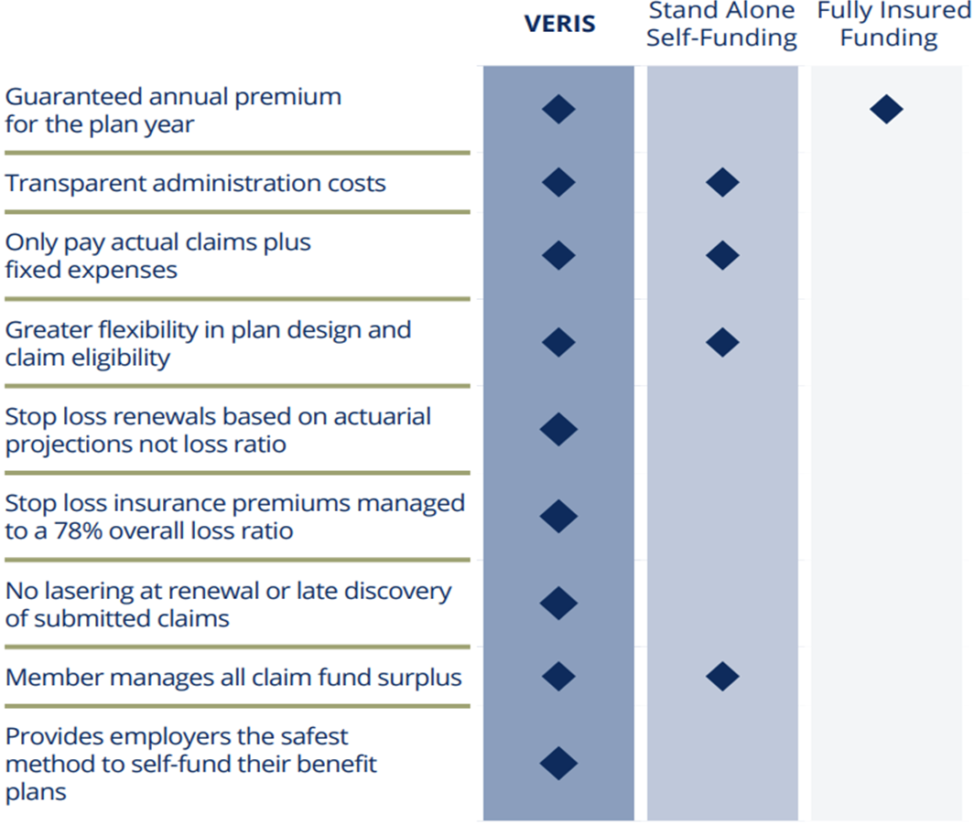
The VERIS Difference
SAVINGS ∙ STABILITY ∙ CONTROL
Notes:
We manage $550 million in stop loss premium, which if you put Benecon out in the open marketplace, makes us the 5th largest stop loss carrier. When you think about stop loss markets, it’s Sun Life, Symetra, HCC, Voya then Benecon.

