Slide 1


Replacing "I" with "We"
From Illness to Wellness with Virtual Care
Notes:
Reduced Absenteeism and Presenteeism:
According to the World Health Organization (WHO), depression and anxiety disorders cost the global economy an estimated $1 trillion per year in lost productivity. WHO also states that every $1 invested in scaled-up treatment for common mental health disorders yields a return of $4 in improved health and productivity.
A 2019 report by Deloitte found that mental health issues, including stress, anxiety, and depression, were responsible for 41% of work-related illnesses, leading to absenteeism (missed workdays) and presenteeism (reduced productivity while at work). The report also noted that for every £1 spent on workplace mental health support in the UK, employers gained £5 in reduced presenteeism, absenteeism, and staff turnover.
Reduced Employee Turnover:
High staff turnover can be costly for businesses due to recruitment and training expenses. According to a study by the Center for American Progress, replacing an employee can cost about 20% of that employee's annual salary. By providing mental health support and creating a positive work environment, employers can reduce turnover rates.
Increased Employee Engagement and Productivity:
A report by Gallup found that highly engaged workplaces had 21% higher profitability and 41% lower absenteeism. Mental health support can improve employee engagement, leading to better productivity and reduced turnover.
Improved Corporate Reputation:
Companies that prioritize mental health and well-being can build a positive corporate reputation, attracting talent and clients. A survey by Cone Communications found that 89% of Americans would switch brands to one associated with a good cause, including employee welfare.

Slide 2


When mental health is ultimately recognized as essential to physical health, not an extraneous element of it, then we will have access to true, complete, modern medicine.
John Campo
Notes:
Professor at ohio state- chair of psychiatry department

Slide 3






MENTAL
Dimensions of
Wellness
ENVIRONMENTAL
SPIRITUAL
Wellness is multidimensional.
INTELLECTUAL
VOCATIONAL
PHYSICAL
3
Notes:
Noise reduction-
Explaining benefits and eligibility questions based on SPDs and SBCs
We cannot quote you your benefits, based on the documents your group has been made available I can provide you THIS- you have 20 PT visits, help get TPA on the line- hand hold Nurses do a warm transfer get another live human on the phone – sometimes stay on for more complex billing situations
Patient receives a bill in the mail- they want to know if OOP is truly their responsibility – has the insurance paid their part? Is this correct? (general billing question)
Warm transfer & help with questions if needed
Am I eligible for coverage for physical therapy after a knee surgery?
If in benefit guide and clear –they can speak more detailed information they go to the TPA
Someone has been having headaches, want a referral or don't know where to go- triage symptoms- have you had diagnostic testing- help steer them to the first level of care- primary care? No
Start with primary care if they don't have one (US!!)
Steerage and navigation
I just got off the call with a primary care physician – office amnesia
4 prongs – start with engagement
Clinical care
Preventive care and disease management through PCP, supported with regular tests, screening, and whole-person clinical guidance. Urgent care for acute conditions.
Screen, diagnose, and treat mental health conditions, with prescription access.
Wraparound support registered dieticians (Nutrition education developed for your goals and lifestyle from a Registered Dietitian.), certified diabetes educators, and health coaches (healthy weight, Personalized exercise & weight loss support from a health advisor)
Navigation
Nurse Advocates assist with medical questions, finding doctors, second opinions, and alternative treatment options.
Access to 13B points of claims data. Referrals for in-person care ensure low-cost, high quality, in-network specialists with availability, proximity to patient, and positive reviews.
Integration with employer-sponsored wellness incentives and benefits programs.
Case Management
Certified Case Managers engage members with complex conditions, unhealthy lifestyles, and high psychosocial risk factors.
Nurses establish customized care plans, educate patients on medical issues & treatment options, and coordinate communication between patients and network providers.
Engagement
A focus on creating new primary care relationships and ensuring adherence to treatment
Detailed follow-ups from the care team around referrals, labs, medication and next steps.

Slide 4
Mental Health
Dimensions of Wellness
3 in 4
WORKERS EXPERIENCE A MENTAL/BEHAVIORAL HEALTH CHALLENGE AT LEAST "SOMETIMES"
Patients who do not receive mental health support:
Experience higher rates of leaves of absence or accommodations for mental health-related issues
Are more likely to leave their employer for better mental health benefits elsewhere
Have poorer performance, report higher stress levels at work and are more likely to get hurt on the job
MENTAL
43%
FEEL THEIR EMPLOYER DOES NOT TALK ABOUT THE IMPORTANCE OF MENTAL HEALTH
1 in 2
LIVE IN A MENTAL HEALTH PROVIDER SHORTAGE AREA
Mental health benefits: Meeting employees' needs (benefitspro.com)
Employee wellness beyond the benefits package (benefitspro.com)
Employee wellness beyond the benefits package (benefitspro.com)
Employees' Stress Over Mental Health Is Affecting Their Work (msn.com)
Workplace wellness programs can help prevent workers' compensation claims | Employee Benefit News
4
Notes:
Noise reduction-
Explaining benefits and eligibility questions based on SPDs and SBCs
We cannot quote you your benefits, based on the documents your group has been made available I can provide you THIS- you have 20 PT visits, help get TPA on the line- hand hold Nurses do a warm transfer get another live human on the phone – sometimes stay on for more complex billing situations
Patient receives a bill in the mail- they want to know if OOP is truly their responsibility – has the insurance paid their part? Is this correct? (general billing question)
Warm transfer & help with questions if needed
Am I eligible for coverage for physical therapy after a knee surgery?
If in benefit guide and clear –they can speak more detailed information they go to the TPA
Someone has been having headaches, want a referral or don't know where to go- triage symptoms- have you had diagnostic testing- help steer them to the first level of care- primary care? No
Start with primary care if they don't have one (US!!)
Steerage and navigation
I just got off the call with a primary care physician – office amnesia
4 prongs – start with engagement
Clinical care
Preventive care and disease management through PCP, supported with regular tests, screening, and whole-person clinical guidance. Urgent care for acute conditions.
Screen, diagnose, and treat mental health conditions, with prescription access.
Wraparound support registered dieticians (Nutrition education developed for your goals and lifestyle from a Registered Dietitian.), certified diabetes educators, and health coaches (healthy weight, Personalized exercise & weight loss support from a health advisor)
Navigation
Nurse Advocates assist with medical questions, finding doctors, second opinions, and alternative treatment options.
Access to 13B points of claims data. Referrals for in-person care ensure low-cost, high quality, in-network specialists with availability, proximity to patient, and positive reviews.
Integration with employer-sponsored wellness incentives and benefits programs.
Case Management
Certified Case Managers engage members with complex conditions, unhealthy lifestyles, and high psychosocial risk factors.
Nurses establish customized care plans, educate patients on medical issues & treatment options, and coordinate communication between patients and network providers.
Engagement
A focus on creating new primary care relationships and ensuring adherence to treatment
Detailed follow-ups from the care team around referrals, labs, medication and next steps.

Slide 5
MENTAL
Dimensions of
Wellness
ENVIRONMENTAL
SPIRITUAL
INTELLECTUAL
VOCATIONAL
PHYSICAL
5
Notes:
Noise reduction-
Explaining benefits and eligibility questions based on SPDs and SBCs
We cannot quote you your benefits, based on the documents your group has been made available I can provide you THIS- you have 20 PT visits, help get TPA on the line- hand hold Nurses do a warm transfer get another live human on the phone – sometimes stay on for more complex billing situations
Patient receives a bill in the mail- they want to know if OOP is truly their responsibility – has the insurance paid their part? Is this correct? (general billing question)
Warm transfer & help with questions if needed
Am I eligible for coverage for physical therapy after a knee surgery?
If in benefit guide and clear –they can speak more detailed information they go to the TPA
Someone has been having headaches, want a referral or don't know where to go- triage symptoms- have you had diagnostic testing- help steer them to the first level of care- primary care? No
Start with primary care if they don't have one (US!!)
Steerage and navigation
I just got off the call with a primary care physician – office amnesia
4 prongs – start with engagement
Clinical care
Preventive care and disease management through PCP, supported with regular tests, screening, and whole-person clinical guidance. Urgent care for acute conditions.
Screen, diagnose, and treat mental health conditions, with prescription access.
Wraparound support registered dieticians (Nutrition education developed for your goals and lifestyle from a Registered Dietitian.), certified diabetes educators, and health coaches (healthy weight, Personalized exercise & weight loss support from a health advisor)
Navigation
Nurse Advocates assist with medical questions, finding doctors, second opinions, and alternative treatment options.
Access to 13B points of claims data. Referrals for in-person care ensure low-cost, high quality, in-network specialists with availability, proximity to patient, and positive reviews.
Integration with employer-sponsored wellness incentives and benefits programs.
Case Management
Certified Case Managers engage members with complex conditions, unhealthy lifestyles, and high psychosocial risk factors.
Nurses establish customized care plans, educate patients on medical issues & treatment options, and coordinate communication between patients and network providers.
Engagement
A focus on creating new primary care relationships and ensuring adherence to treatment
Detailed follow-ups from the care team around referrals, labs, medication and next steps.

Slide 6
Physical Health
Dimensions of Wellness
60%
US Adults -
no Primary Care Visits in last 2-3 Years
Patients who do not use primary care:
Incur more health plan costs
Use more unnecessary healthcare services (e.g., ER)
Receive fewer preventive screenings
Have higher rates of mortality and morbidity
PHYSICAL
1 in 3
Patients live in a PCP health Professional Shortage Area
1+
Month Average wait time For A New patient appointment
Primary Care: Our First Line of Defense | Commonwealth Fund
Daily Briefing: Primary Care | Advisory Board
Primary Care Health Professional Shortage Areas (HPSAs) | KFF
Forbes: Doctor Wait Times Average Almost Four Weeks In Big Cities
6
Notes:
Noise reduction-
Explaining benefits and eligibility questions based on SPDs and SBCs
We cannot quote you your benefits, based on the documents your group has been made available I can provide you THIS- you have 20 PT visits, help get TPA on the line- hand hold Nurses do a warm transfer get another live human on the phone – sometimes stay on for more complex billing situations
Patient receives a bill in the mail- they want to know if OOP is truly their responsibility – has the insurance paid their part? Is this correct? (general billing question)
Warm transfer & help with questions if needed
Am I eligible for coverage for physical therapy after a knee surgery?
If in benefit guide and clear –they can speak more detailed information they go to the TPA
Someone has been having headaches, want a referral or don't know where to go- triage symptoms- have you had diagnostic testing- help steer them to the first level of care- primary care? No
Start with primary care if they don't have one (US!!)
Steerage and navigation
I just got off the call with a primary care physician – office amnesia
4 prongs – start with engagement
Clinical care
Preventive care and disease management through PCP, supported with regular tests, screening, and whole-person clinical guidance. Urgent care for acute conditions.
Screen, diagnose, and treat mental health conditions, with prescription access.
Wraparound support registered dieticians (Nutrition education developed for your goals and lifestyle from a Registered Dietitian.), certified diabetes educators, and health coaches (healthy weight, Personalized exercise & weight loss support from a health advisor)
Navigation
Nurse Advocates assist with medical questions, finding doctors, second opinions, and alternative treatment options.
Access to 13B points of claims data. Referrals for in-person care ensure low-cost, high quality, in-network specialists with availability, proximity to patient, and positive reviews.
Integration with employer-sponsored wellness incentives and benefits programs.
Case Management
Certified Case Managers engage members with complex conditions, unhealthy lifestyles, and high psychosocial risk factors.
Nurses establish customized care plans, educate patients on medical issues & treatment options, and coordinate communication between patients and network providers.
Engagement
A focus on creating new primary care relationships and ensuring adherence to treatment
Detailed follow-ups from the care team around referrals, labs, medication and next steps.

Slide 7
MENTAL
Dimensions of
Wellness
ENVIRONMENTAL
SPIRITUAL
INTELLECTUAL
VOCATIONAL
PHYSICAL
7
Notes:
Noise reduction-
Explaining benefits and eligibility questions based on SPDs and SBCs
We cannot quote you your benefits, based on the documents your group has been made available I can provide you THIS- you have 20 PT visits, help get TPA on the line- hand hold Nurses do a warm transfer get another live human on the phone – sometimes stay on for more complex billing situations
Patient receives a bill in the mail- they want to know if OOP is truly their responsibility – has the insurance paid their part? Is this correct? (general billing question)
Warm transfer & help with questions if needed
Am I eligible for coverage for physical therapy after a knee surgery?
If in benefit guide and clear –they can speak more detailed information they go to the TPA
Someone has been having headaches, want a referral or don't know where to go- triage symptoms- have you had diagnostic testing- help steer them to the first level of care- primary care? No
Start with primary care if they don't have one (US!!)
Steerage and navigation
I just got off the call with a primary care physician – office amnesia
4 prongs – start with engagement
Clinical care
Preventive care and disease management through PCP, supported with regular tests, screening, and whole-person clinical guidance. Urgent care for acute conditions.
Screen, diagnose, and treat mental health conditions, with prescription access.
Wraparound support registered dieticians (Nutrition education developed for your goals and lifestyle from a Registered Dietitian.), certified diabetes educators, and health coaches (healthy weight, Personalized exercise & weight loss support from a health advisor)
Navigation
Nurse Advocates assist with medical questions, finding doctors, second opinions, and alternative treatment options.
Access to 13B points of claims data. Referrals for in-person care ensure low-cost, high quality, in-network specialists with availability, proximity to patient, and positive reviews.
Integration with employer-sponsored wellness incentives and benefits programs.
Case Management
Certified Case Managers engage members with complex conditions, unhealthy lifestyles, and high psychosocial risk factors.
Nurses establish customized care plans, educate patients on medical issues & treatment options, and coordinate communication between patients and network providers.
Engagement
A focus on creating new primary care relationships and ensuring adherence to treatment
Detailed follow-ups from the care team around referrals, labs, medication and next steps.

Slide 8
Everything In-Between with Health Coaching
Dimensions of Wellness
REPORTING SHOWS:
Coaching is effectively delivered via telephone and virtually
Helps patients favorably modify behaviors
Those with chronic conditions can significantly improve health
It results in a favorable population shift from higher to lower health-risk levels for employees
Health coaching reduced mental distress
VOCATIONAL
An employer without wellness-centric benefits:
Lose top talent to more empathetic employers. 80% of survey respondents said they would be willing to leave their jobs.
Experience higher rates of absenteeism due to poor wellbeing.
Have poorer job satisfaction. Only 50% of employees say they have seen an increase in support for wellbeing.
INTELLECTUAL
SPIRITUAL
ENVIRONMENTAL
Employees' Stress Over Mental Health Is Affecting Their Work (msn.com)
Consumers prefer both in-person and virtual medical care options, study finds (benefitspro.com)
Despite increased focus by employers, workers expect more wellbeing benefits (benefitspro.com)
Clinical Effectiveness of Lifestyle Health Coaching - PMC (nih.gov)
Health coaching provided by registered nurses described: a systematic review and narrative synthesis - PMC (nih.gov)
8
Notes:
Noise reduction-
Explaining benefits and eligibility questions based on SPDs and SBCs
We cannot quote you your benefits, based on the documents your group has been made available I can provide you THIS- you have 20 PT visits, help get TPA on the line- hand hold Nurses do a warm transfer get another live human on the phone – sometimes stay on for more complex billing situations
Patient receives a bill in the mail- they want to know if OOP is truly their responsibility – has the insurance paid their part? Is this correct? (general billing question)
Warm transfer & help with questions if needed
Am I eligible for coverage for physical therapy after a knee surgery?
If in benefit guide and clear –they can speak more detailed information they go to the TPA
Someone has been having headaches, want a referral or don't know where to go- triage symptoms- have you had diagnostic testing- help steer them to the first level of care- primary care? No
Start with primary care if they don't have one (US!!)
Steerage and navigation
I just got off the call with a primary care physician – office amnesia
4 prongs – start with engagement
Clinical care
Preventive care and disease management through PCP, supported with regular tests, screening, and whole-person clinical guidance. Urgent care for acute conditions.
Screen, diagnose, and treat mental health conditions, with prescription access.
Wraparound support registered dieticians (Nutrition education developed for your goals and lifestyle from a Registered Dietitian.), certified diabetes educators, and health coaches (healthy weight, Personalized exercise & weight loss support from a health advisor)
Navigation
Nurse Advocates assist with medical questions, finding doctors, second opinions, and alternative treatment options.
Access to 13B points of claims data. Referrals for in-person care ensure low-cost, high quality, in-network specialists with availability, proximity to patient, and positive reviews.
Integration with employer-sponsored wellness incentives and benefits programs.
Case Management
Certified Case Managers engage members with complex conditions, unhealthy lifestyles, and high psychosocial risk factors.
Nurses establish customized care plans, educate patients on medical issues & treatment options, and coordinate communication between patients and network providers.
Engagement
A focus on creating new primary care relationships and ensuring adherence to treatment
Detailed follow-ups from the care team around referrals, labs, medication and next steps.

Slide 9
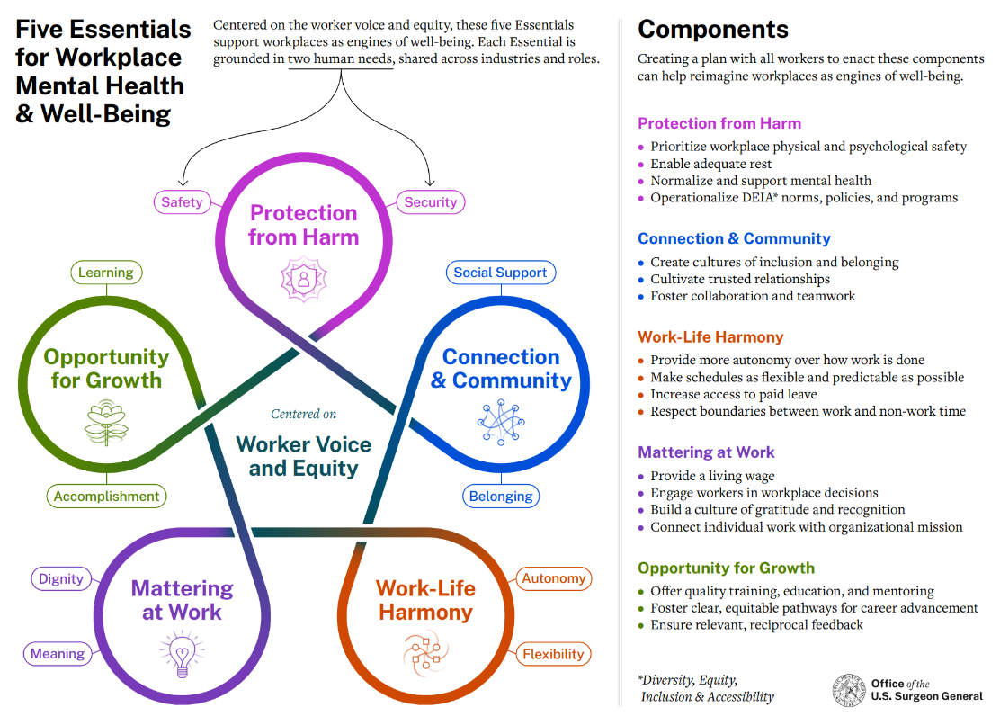
The Employer’s Sphere of Influence
Equity &
Inclusion
At Work
Leadership & Manager
Coaching
Purpose, Play, Potential, Pressure
Notes:
Microsoft Teams Chat Files - OneDrive (sharepoint.com)

Slide 10
The Impact We Can Have
1.6x higher likelihood of employee retention.
Average return of $4 for every $1 invested.
Mean 8% salary savings after 6 months.
Assessing the impact of a comprehensive mental health program on frontline health service workers - PMC (nih.gov)
Clinical and Financial Outcomes Associated With a Workplace Mental Health Program Before and During the COVID-19 Pandemic - PMC (nih.gov)
Mental Health Employer Cost Calculator - National Safety Council (nsc.org)
Notes:
Microsoft Teams Chat Files - OneDrive (sharepoint.com)

Slide 11

Virtual Care
“The doctor was amazing. She took her time and educated me on my immediate issue and ways to prevent future problems.
I've never felt so seen or cared for by a doctor.”

Slide 12




Healthcare Attitudes & Changing Behavior
THE SCIENCE BEHIND OUR MODEL
HEALTH-DRIVEN
HEALTHCARE-AVOIDANT
Consistent due to need (chronic illness) or desire for partner in preventive & acute health issues
Limited due to time, money or trust constraints
HEALTHCARE
USE
Fogg Behavior Model
Make it easy, understand motivation, and prompt
HEALTHCARE
PAIN POINTS
The inconvenience of certain processes. Not having enough time with a doctor
The inconvenience of just getting care
Lack of trust in doctors. Lack of awareness.
Health Behavior Change Model
Educate members on how FSH will help achieve goals
Alternative to health support methods (convenience). Supplement to in-person care (savings)
Alternative to in-person care overall (convenience). Simple and easy-to-use care (low effort to adopt)
HEALTHCARE
NEEDS/
DESIRES
Access to $0, Network Agnostic Counseling
Physical & Mental Health Integration
Coaching, Specialized in Behavior Change
Nudge Theory (Personalization)
Deliver the most relevant messaging to each individual.
Reroute current behavior
Prompt new, health-driven behavior
Notes:
Anyone can send an email to a patient- why do yours work? Precision of behavioral science. Intentionality. Understanding patient behavior and responding, individually, accordingly.
Two types of patient attitudes we're working to address with a high engagement virtual care solution
Health- driven
Someone who uses healthcare today, maybe has a PCP, but because of inconvenience or cost or time isn't OPTIMIZING their use (heavy ER, not taking medications, not follow-ing up)
Re route current behaviors
Healhcare-avoidant
Limited use due to lack of trust, inertia, lack of availability or knowledge
Get engage- prompt new health driven behavior
Because of how we approach engagement – for most of our clients, we are able to meaningfully change the way their folks interact with healthcare and their health plan overall- we can address STRATEGIC benefit goals that YOU have for your clients.

Slide 13
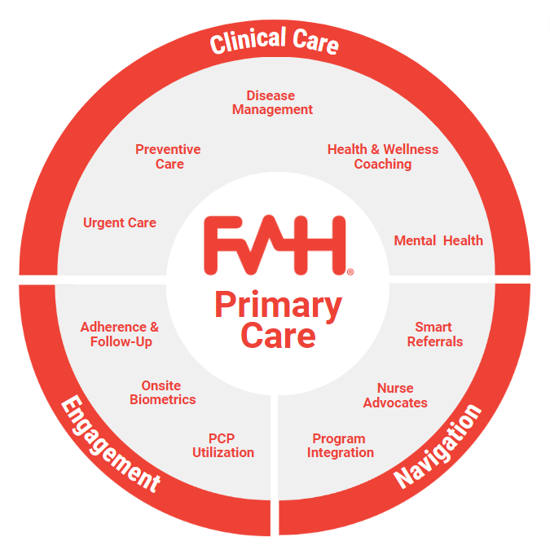

Urgent Care
Primary Care Strategy
24/7 access to a virtual doctor for minor illness and injury. Connect in minutes via phone, app, or web.
Preventive Care
Routine check-ups and lab or screening referrals to track overall health. Aligned with United States Preventive Services Task Force (USPSTF) guidelines.
Chronic Care
Through motivational interviewing and more frequent (no limit on the number of visits), longer visits with a doctor, members can get hands-on based support for better disease management for a variety of chronic conditions.
Coaching
Wrap-around support from a broader network of providers will be available and members will have access to certified diabetes educators, nutritionists, and certified health coaches for things like tobacco cessation, pregnancy, healthy heart, healthy mom and healthy baby, and more.
Advanced Clinical & Benefits Navigation
Care coordination and referrals based on in-network status, proximity to patient, soonest appointment availability, cost and quality. Nurses to support steerage to other medical benefits. benefits and billing questions, general patient questions and follow-up.
$0 Patient Copay
Appts. As Soon As Next Day
Phone, App, or Web
13
Notes:
Noise reduction-
Explaining benefits and eligibility questions based on SPDs and SBCs
We cannot quote you your benefits, based on the documents your group has been made available I can provide you THIS- you have 20 PT visits, help get TPA on the line- hand hold Nurses do a warm transfer get another live human on the phone – sometimes stay on for more complex billing situations
Patient receives a bill in the mail- they want to know if OOP is truly their responsibility – has the insurance paid their part? Is this correct? (general billing question)
Warm transfer & help with questions if needed
Am I eligible for coverage for physical therapy after a knee surgery?
If in benefit guide and clear –they can speak more detailed information they go to the TPA
Someone has been having headaches, want a referral or don't know where to go- triage symptoms- have you had diagnostic testing- help steer them to the first level of care- primary care? No
Start with primary care if they don't have one (US!!)
Steerage and navigation
I just got off the call with a primary care physician – office amnesia
4 prongs – start with engagement
Clinical care
Preventive care and disease management through PCP, supported with regular tests, screening, and whole-person clinical guidance. Urgent care for acute conditions.
Screen, diagnose, and treat mental health conditions, with prescription access.
Wraparound support registered dieticians (Nutrition education developed for your goals and lifestyle from a Registered Dietitian.), certified diabetes educators, and health coaches (healthy weight, Personalized exercise & weight loss support from a health advisor)
Navigation
Nurse Advocates assist with medical questions, finding doctors, second opinions, and alternative treatment options.
Access to 13B points of claims data. Referrals for in-person care ensure low-cost, high quality, in-network specialists with availability, proximity to patient, and positive reviews.
Integration with employer-sponsored wellness incentives and benefits programs.
Case Management
Certified Case Managers engage members with complex conditions, unhealthy lifestyles, and high psychosocial risk factors.
Nurses establish customized care plans, educate patients on medical issues & treatment options, and coordinate communication between patients and network providers.
Engagement
A focus on creating new primary care relationships and ensuring adherence to treatment
Detailed follow-ups from the care team around referrals, labs, medication and next steps.

Slide 14
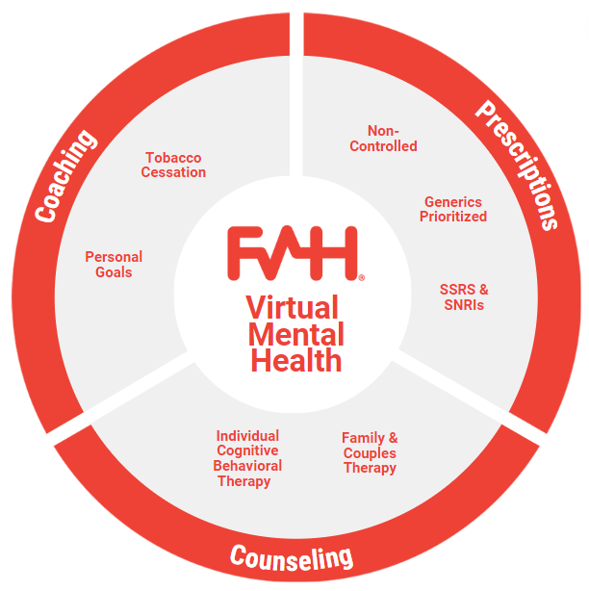

Mental Health Strategy
Coaching
Guidance from behavioral coaches around tobacco cessation, lifestyle and wellness goals, etc.
Individual, Family, & Couples Counseling
Short-term and long-term therapy from licensed psychologists and LCSWs based in cognitive behavioral science. Support for things like grief, anxiety, stress, depression, substance use, family issues, workplace issues, couples counseling, etc.
Prescriptions
Access to a doctor if pharmacotherapy is needed. Medication support for SSRIs and SNRIs.
$0 Patient Copay
No Pre-Defined Session Limit
Talk to a Human in Minutes,
Schedule in <3 Days
Phone, App, or Web
14
Notes:
1/1/2025: Whole Mental Health Our commitment to broadening our reach in the behavioral and mental health space.
1) collaborative care model. mental health will involve proactive steerage not only within the existing FSH infrastructure (i.e. to PCP for RX or to other services we provide) but also they will act as consultants for external services (i.e. if someone is in a relationship with a psychiatrists or an in patient
2) longer term relationship based mode- we can support ANY clinical indication except active psychosis and in-patient drug rehab. the patient spends more time with their CHOSEN counselor and an average of 8-10 visits, can look like weekly therapy for a YEAR if it needs to
3) we have "step down" therapy- i.e. coaching for people who aren't ready for therapy but want to talk about job coaching, vision planning, wellness, and other mental health<> physical health goals

