Slide 1
Jandra Cox
Estate Planning Attorney
Premier Legal, PLC
5709 NW 132nd St.
Oklahoma City, OK 73142
405-985-4376 (mobile)

Slide 2
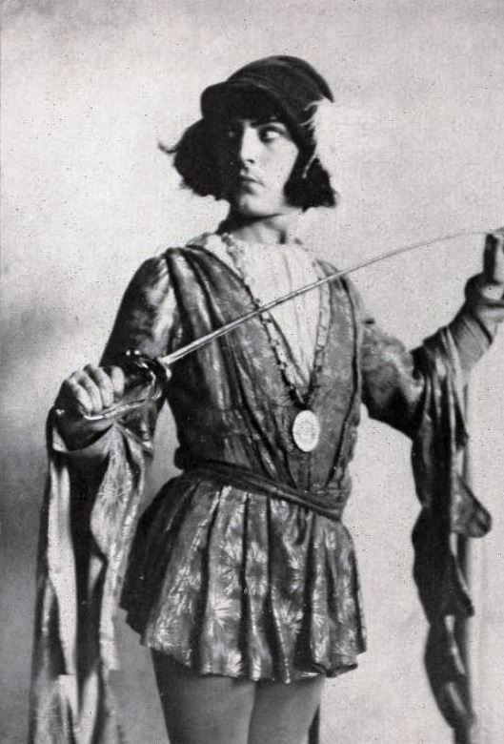
“[T]omorrow … you shall find me a grave man.”
Mercutio, after being stabbed by Tybalt, in Romeo and Juliet by William Shakespeare

Slide 3

Life changes in an instant.

Slide 4

Very few people want to think about, talk about, or plan for death
… until a scare.
…and that is often too late.

Slide 5


Slide 6
They “take care of things”
themselves:

Slide 7
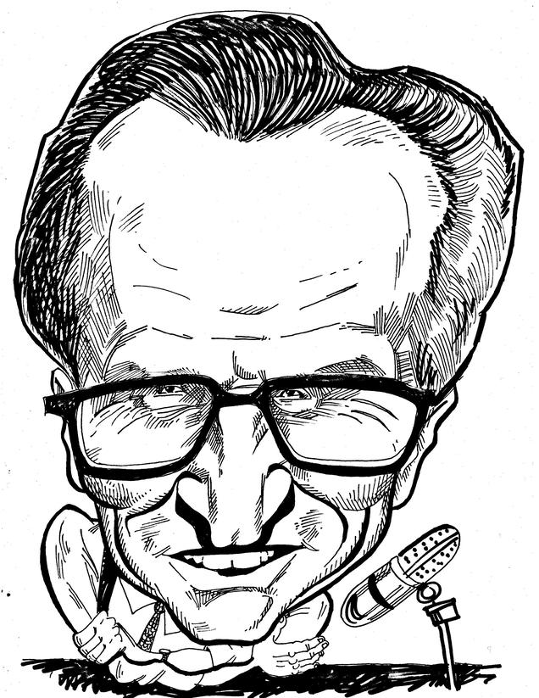
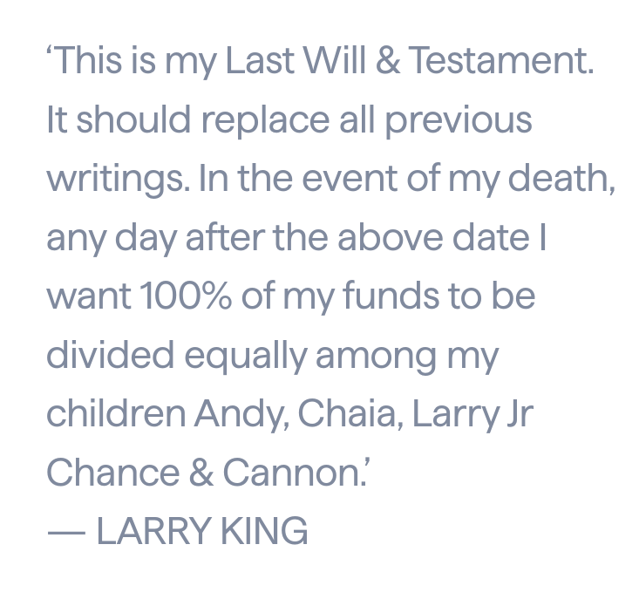
1. Is this a “legal” document in California? Who is executor?
2. Chaia and Andy both died in 2020. Who gets their share?
3. Larry Jr. had borrowed $250K against his future inheritance. Is it a conflict of interest to have him be the executor?
4. Larry King had had a stroke before he wrote the 2019 letter. Was he competent?
5. Larry King was divorcing his 7th wife when he died. What are her rights/responsibilities/benefits?
2019
Handwritten
2021
Died

Slide 8
They don’t keep their
documents updated:

Slide 9
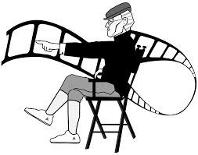
1. Slipped into a coma in April of 2019
2. Family discovered he had no Medical Directive or POA.
3. Big fight over guardianship of him.
4. Died 13 days later with old 1993 Will.
5. In the 26 years after drafting his Will, he had fathered 6 more kids with various women.
6. The value of his estate was $38MM
John Singleton
Hollywood filmmaker, director, producer

Slide 10


Heath Ledger
Old Will: Half to parents; half to siblings
2005: Had a baby with his girlfriend
2008: Died with old Will in place
In New York, a pretermitted heir is entitled to a portion, but s/he has to prove paternity and make a claim in court. His $20MM was in AUSTRALIA.

Slide 11
They trust the wrong family
members:

Slide 12

Beverley Schottenstein
AMERICAN EAGLE
DSW
When she retired, she trusted her grandsons to manage $80MM and designated them as fiduciaries.
They were financial advisors at JP Morgan.
The grandsons placed assets in risky investments that lost her $10MM but earned them hefty commissions.
The grandsons charged so much on her credit card each month that the account was frozen for over-activity.
At 91, she had to sue them and was awarded $19MM … but their family was torn apart.

Slide 13
4. They do nothing:

Slide 14


Prince
Passed away suddenly in 2016
No estate planning
No wife, no children
Millions of dollars in his estate
Only heirs were siblings and their children
His “intestate” probate took 6 years to settle

Slide 15
They make hasty or dodgy
decisions during a crisis:

Slide 16



Robert Kardashian
8 WEEKS BEFORE HIS DEATH
Diagnosed with esophageal cancer
6 WEEKS BEFORE HIS DEATH
Married Ellen Pierson
He had a HOLOGRAPHIC Will

Slide 17

Legal documents are the foundation of a good plan.

Slide 18

Who has been through a probate?

Slide 19

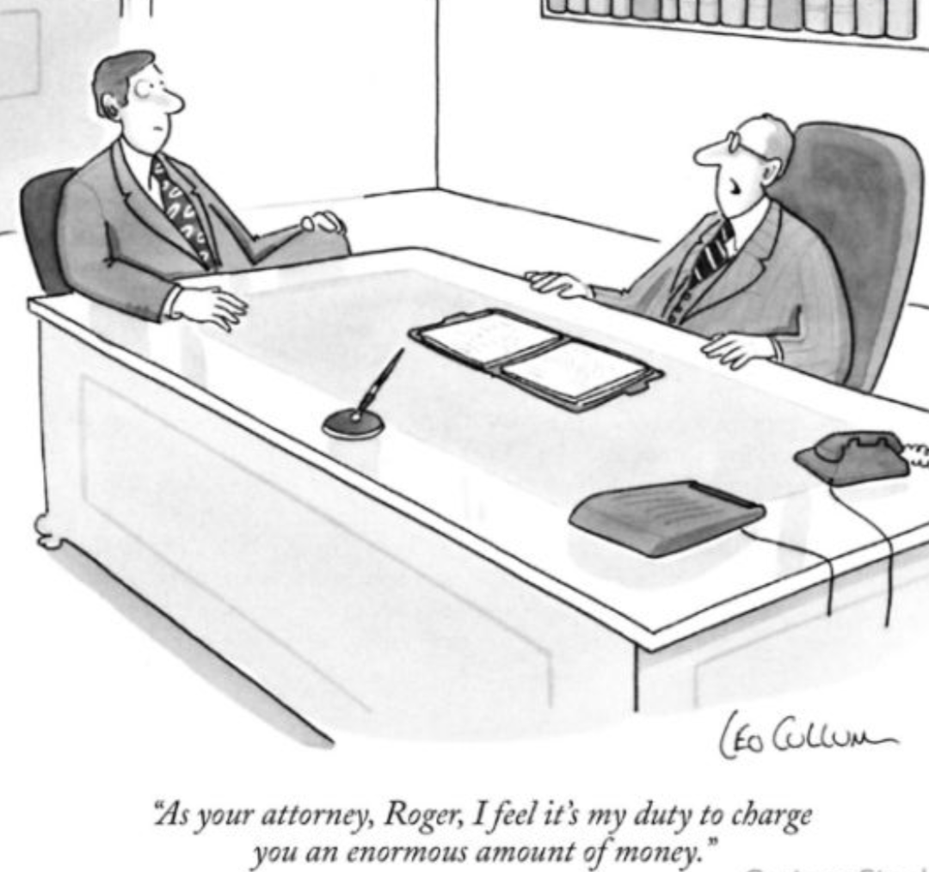

Slide 20
* Find your Will.
* Get your death certificate.
* Find and hire probate lawyer. Pay retainer.
* Publish notice in newspaper.
* Attend hearing. Executor appointed.
* Notice to creditors. (Wait 2 months)
* Hearing.
* Notice to heirs/beneficiaries.
* Hearing.
* Inventory Estate. Provide accounting to court.
* Hearing.
* Pay debts and taxes.
* Hearing. Final accounting.
* Distribute.

Slide 21

Suze Orman, the popular financial guru, goes so far as to say that “everyone” needs a revocable living trust.

Slide 22

A trust is like a basket/bucket to hold assets.

Slide 23
BENEFITS OF TRUSTS
AVOIDS PROBATE, which saves time and money
PROTECTS the PRIVACY of you and your beneficiaries
Minimizes ESTATE TAXES (if applicable)
Protects you in case of INCAPACITY (illness or disability)
Offers CONTROL (who gets your stuff, specific use of assets, no oversight by court, etc.)
Offers FLEXIBILITY (easily and inexpensively amended)
PROTECTS MINORS (guardianship, custody)
Keeps disgruntled heirs from CONTESTING your wishes

Slide 24

Legal Documents
Trust
Pour-over Will
Durable Power of Attorney – Finances
Durable Power of Attorney – Health
Directive to Physicians
“Living Will”/ “Advance Directive”
HIPAA Authorization
Remains Affidavit
Letter of Instruction
Memorandum of Trust
Declaration of Intent
Deed(s) and Affidavit(s)
Funding Letters – POD and CB

Slide 25

Recent Developments in Estate Law

Slide 26


Federal Death Tax Exemption
2025: $13.99MM/$27.98 (on EXCESS)
Most people do NOT need a tax attorney – $$$
If my clients need tax strategies (irrevocable/ life insurance trusts, dynasty trusts, spousal lifetime access trusts, grantor-retained annuity trusts, charitable trusts, etc.), I pull a tax expert in.

Slide 27


POA Health
Until Nov. 1, 2021, Oklahoma allowed people to create a POA to address health care decisions (up to the end of life decisions in an Oklahoma Advance Directive). 58 Okla. Stat. §1072.1
In 2021, the Oklahoma Legislature enacted a new Uniform Power of Attorney Act (58 Okla. Stat. §3001 et. seq.) and repealed the Uniform Durable Power of Attorney Act, meaning Oklahomans could create a POA for many decisions, but not health care. (The Legislature tried to improve POA law, but forgot health care.)
In 2022, the Oklahoma Legislature enacted the Oklahoma Health Care Agent Act (63 Okla. Stat. §3111.1 et. seq.), which restored one’s ability to create a POA for health, too.

Slide 28

New Deed Requirement (Affidavit)
Former law: “Bona fide resident” alien could hold real property. If s/he/it moved, had to sell within 5 years.
Nov. 1, 2023: Each person coming into possession of real property must separately sign an affidavit, swearing:
1. S/he is 18 years old
2. S/he is a U.S. citizen or alien who is/may become “bona fide resident” of Oklahoma
3. If Trust, trustees & direct and contingent beneficiaries are U.S. citizens or “bona fide Oklahoma residents”
4. Acknowledgement of the ban on prohibited funding source

Slide 29

WHY?
Growing number of foreign-owned marijuana-farming operations

Slide 30
Unknowns
1. How does a minor comply?
2. What is the penalty for non-compliance?
3. What if you want to change your beneficiaries? Need new deeds?
4. What if you don’t want your beneficiaries to know they are beneficiaries (or your children that they are NOT beneficiaries)?
4. Can each county have different requirements for recording?

Slide 31


Oklahoma’s New Trust Decanting Statute
Effective Nov. 1, 2023
Allows Trustees to “refresh” Trusts to accomplish the original goals (new tax laws, sale of property laws, new investment tools, new substance abuse/ spendthrift/ special needs)
Notice to affected beneficiaries, including:
Trustee intends to exercise power of distribution
Description what Trustee intends to do and how and when
Beneficiary has right to object and/or petition the Court approve, modify, or deny Trustee’s plan
Copies of old and new proposed Trust
90 days’ notice

Slide 32


New Corporate Transparency Act
Effective Jan. 1, 2024
Corporations, LLCs, or any entity created by filing organizational docs with OK Secretary of State
Must file “Beneficial Ownership Information” (BOI) with the U.S. Treasury, listing legal name, trade name, business address, State, and TIN/EIN of company PLUS at least one beneficial owner and one company applicant
Makes is harder to operate shell companies for illicit purposes (terrorist funding, money laundering, selling narcotics, sex trafficking)
Exceptions: SEC reporting companies, investment companies/advisors, banks, insurers, tax exempt entities, governmental entities, other highly-regulated … But no exception for law firms
What about trusts? (which don’t file with the SOS)
Penalties: $500/day or $10,000 total

Slide 33
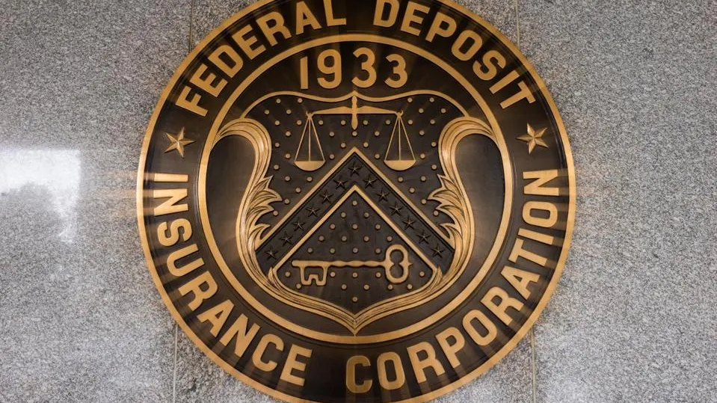
FDIC Changes Deposit Insurance For Trust Accounts (April 1, 2024)
$250,000 per beneficiary (up to 5 beneficiaries insured)
$1.25MM per trust owner per insured institution
Revocable or irrevocable trust & includes POD/TOD accounts
https://www.forbes.com/sites/bobcarlson/2024/05/27/fdic-changes-deposit-insurance-for-trust-accounts/?sh=51023a81f044

Slide 34
Jandra Cox
Estate Planning Attorney
Premier Legal, PLC
5709 NW 132nd St.
Oklahoma City, OK 73142
405-985-4376 (mobile)

Slide 35
Problems with Dresser Drawer/ TOD Deed
Unintentional disinheritance
Joint tenant problems (if joint tenant divorces)
Conflicts with other estate planning documents
Inaccuracies in legal description
Transferee passes away before Transferor. (And if minors, court proceeding.)
Transferee liable for debts (mortgage, prop. tax, capital gains taxes, insurance probs)
90-days to claim property, and everything is public

