Slide 1
Chart Your Course
The ACA Compliance Journey
Notes:
ESB-9682-0524
Read slide.

Slide 2
Disclaimer
We do not provide financial, tax, or legal advice. While we’re happy to provide you with this general information, given the complexity of these rules, we encourage you to contact your tax or legal counsel about how the requirements apply to your specific plans or situation.
Notes:
ESB-9682-0524
Read slide.

Slide 3
Why should you know about the ACA?
ACA compliance challenges for organizations
Uncertainty in IRS code application
Dependence on external ACA compliance help
Notes:
ESB-9682-0524
Some of you might be here for the CE credits, which is great, but let's dive into why the ACA matters to you, outside of your CE obligation.
As CPAs, whether working for clients or within a company, the ACA impacts your role.
Quick show of hands—who's had a client inquire about the ACA?
Without your guidance on the ACA, clients will turn elsewhere for support.
Compliance with the ACA employer mandate is a common struggle, evidenced by the IRS penalty letters I see regularly.
Many are unsure about the correct IRS codes and filing procedures. Today, we'll address these uncertainties and provide resources for clarity.
The ACA compliance learning curve is steep, so partnering with a specialist is key. You don't have to be the ACA expert—just have the right partner to support your clients and protect your business from losing out to competitors.

Slide 4
ACA Fundamentals
Let’s Look At The Basics
Notes:
ESB-9682-0524
Read slide.

Slide 5
Benefit Eligibility vs Employer Mandate
"Bronze" Plan to All Employees
Benefits Based on Full-Time Equivalency (FTE)
Benefits Based on Contract, Position, or Bargaining Unit - Benefits tied to specific employment terms.
Pro Rata Employer Contribution - Employer contributions based on employee status.
Innovative Approaches to Benefits Administration
Notes:
ESB-9682-0524
Firstly, one approach is to offer a minimum value plan, often referred to as a "Bronze" plan, to all employees. This includes part-time, seasonal, or variable hour workers, such as substitutes. This ensures that every member of our team has access to essential health coverage.
Another method is to offer benefits based on Full-Time Equivalency. This means that benefits are tailored according to the number of hours an employee works, ensuring that full-time employees receive a full suite of benefits, with part-time employees receiving a proportional amount.
We can also choose to offer benefits based on an employee's contract, their specific position, or the bargaining unit they belong to. This allows for benefits to be customized and negotiated, reflecting the unique needs and contributions of different groups within our organization.
Another option is to offer benefits to all employees but to pro-rate the employer's contribution. This means that while all employees can receive benefits, the amount that the company pays towards those benefits is adjusted based on factors such as hours worked or job status.
Lastly, we're not limited to traditional methods. We can explore innovative approaches to benefits administration. This could involve unique wellness programs, flexible spending accounts, or other creative solutions that meet the needs of our diverse workforce.

Slide 6
Employer Mandate
Employer penalty may apply if:
No coverage offered to full-time employees and their dependent children up to age 26 or
Coverage offered is “unaffordable” or “inadequate” and
Full-time employee enrolls in Marketplace coverage and receives advance premium tax credit
Notes:
ESB-9682-0524
Employers are encouraged to offer health coverage primarily through the application of the Employer Mandate Penalty. This is also sometimes referred to as the employer shared responsibility provision or the play or pay mandate.
Large employers that do not offer health coverage to full-time employees and their dependents, or offer coverage that is “unaffordable” or “inadequate”, and have at least one employee enroll in Exchange (Marketplace) coverage and qualify for a federal premium tax credit or cost-sharing reduction, must pay a penalty. The idea is that an employer does not have to offer coverage, but if the employer doesn’t provide adequate and affordable coverage, and instead the employee receives a tax credit to purchase coverage, then the employer must share in the responsibility by paying a penalty.

Slide 7
Who are Full Time Employees?
Full-time for ACA purposes ≠ “benefit eligible”
Full-time under ACA is a legal term
Specific meaning defined by IRC regulations
May not line up with the way employer administers benefits
Necessary for correct ACA reporting
Notes:
ESB-9682-0524
Today, we're going to clarify a common misconception regarding employee status under the Affordable Care Act (ACA) versus benefit eligibility within our company. It's important to recognize that being considered full-time under the ACA does not automatically mean an employee is eligible for our company's benefits.
The term 'full-time' under the ACA has a specific legal definition, which is outlined by the Internal Revenue Code regulations. This definition is based on the number of hours an employee works and is used to determine their eligibility for health coverage under the ACA.
It's essential to understand that this ACA full-time status might not align with how we, as an employer, administer our benefits. For example, our company may have different criteria for when an employee becomes eligible for certain benefits, such as retirement plans or paid time off.
Lastly, correctly identifying employees as full-time under the ACA is not just a matter of internal policy—it's a legal requirement for accurate ACA reporting. Misclassification can lead to penalties and compliance issues, so it's critical that our reporting reflects the ACA's definitions and requirements.

Slide 8
Employer Mandate
Full-time employees:
Average of 30+ hours/week or 130+ hours/month
Average includes non-work time for which pay is due
Optional lookback measurement and stability periods can be used to determine full-time status
Special treatment of newly-hired variable hour, part-time, or seasonal employees under the lookback method
Notes:
ESB-9682-0524
The Internal Revenue Code (IRC) regulations include rules for determining who is a “full-time employee” for purposes of the Employer Mandate. Under the monthly method, full-time status is determined for each month and an employee who averages 30+ hours a week (or 130 hours in a calendar month) is considered a full-time employee. The employer can choose whether to use the weekly or monthly measurement so long as it applies the rule on a reasonable and consistent basis.
The regulations clarify that full-time status is based on “hours of service,” which include non-work time for which pay is due, such as paid time off for vacation, holiday, illness, incapacity (including disability), layoff, jury duty, military duty, or leave of absence. There is no limit on the amount of paid leave that must be taken into account. Unpaid FMLA or USERRA military leave also count.
For employees not expected to work 30+ hours a week, an offer of coverage must still be made if these employees do work 30+ hours a week. Employers may count these employees’ time in one of the ways outlined in the regulations. Using the look-back method, if an employee was considered full-time during the “measurement period,” the employee must be treated as a full-time employee for benefits purposes for a subsequent “stability period” regardless of the employee’s number of hours worked during the stability period, so long as the individual remains an employee. If the employee was considered part-time (worked less than 30 hours per week) during the measurement period, the employee may be treated as part-time for benefits purposes throughout the stability period. The stability period must be at least as long as the measurement period, and not shorter than six months. For newly hired variable hour, part-time, or seasonal employees who are not reasonably expected to work a full-time schedule, the employer can use an initial measurement period (of between 3 and 12 calendar months) to determine whether an employee averaged 30+ hours of service per week.

Slide 9
Terminology
Measurement Period: Track hours to determine "full-time" status for IRS reporting in the next Stability Period.
Administrative Period: Time between Measurement and Stability Periods for calculations and Open Enrollment.
Stability Period: Offer medical coverage to "full-time" employees and dependents from Measurement Period or risk ACA penalties.
Notes:
ESB-9682-0524
Measurement Period – This is the time when all hours are measured and tracked for all employees to determine who will qualify as a “full time” employee, and therefore must be reported as such to IRS, for the subsequent Stability Period.
Administrative Period – This is the period between the Measurement Period and Stability Period to allow for calculations and generally Open Enrollment takes place during this time
Stability Period – This period of time is when any employees who qualified as “full time” during the preceding Measurement Period and their dependent children must be offered adequate and affordable medical coverage or the employer is at risk for a penalty for not doing so under the Employer Mandate (4980H) provision of ACA

Slide 10
Using the Lookback Period
To be full-time under the ACA, an employee must work on average of 30 or more hours per week, or 130 hours per month
During the employer’s standard measurement period OR
During a newly-hired variable hour, part-time or seasonal employee’s initial measurement period
Notes:
ESB-9682-0524
When we talk about full-time employment under the Affordable Care Act, or ACA, we're referring to a specific threshold that determines eligibility for health coverage. An employee is considered full-time if they work an average of 30 hours or more per week, which equates to 130 hours or more per month.
To accurately assess whether an employee meets this full-time criterion, employers use two types of measurement periods. The first is the Standard Measurement Period, which is a set duration that an employer uses to review the average hours worked by ongoing employees. This period helps employers determine if their current staff are working enough hours on average to be considered full-time under the ACA.
The second is the Initial Measurement Period, which applies to new employees who are variable hour, part-time, or seasonal. This period allows employers to evaluate the average hours worked by these new hires to see if they meet the full-time threshold.
Understanding these measurement periods is essential for both accurate ACA reporting and ensuring that employees receive the correct health coverage benefits. It's also important for employees to be aware of how their hours are being measured and how this affects their benefit eligibility.

Slide 11
Using the Lookback Period
Jan 1, 2025 Stability Period:
Measure Nov 1, 2023 – Oct 31, 2024
Admin period Nov 1, 2024 – Dec 31, 2024
Full- or part- time status locked in Jan 1, 2025 – Dec 31, 2025
Oct 1, 2025 Stability Period:
Measure Aug 1, 2024 – Jul 31, 2025
Admin period Aug 1, 2025 – Sep 30, 2025
Full- or part- time status locked in Oct 1, 2025 – Sep 30, 2026
Notes:
ESB-9682-0524
The Lookback Measurement Method is a key component of ACA compliance, allowing employers to determine the full-time or part-time status of their employees for future stability periods.
For the stability period starting on January 1, 2024, we measure employees' hours from November 1, 2022, through October 31, 2023. Following this, we have an administrative period from November 1, 2023, to December 31, 2023, which gives us time to analyze the data, notify employees, and make any necessary adjustments to benefits eligibility.
Once we enter the stability period on January 1, 2024, the employees' full-time or part-time status is locked in for the entire year, regardless of any changes in their working hours during this period.
Similarly, for the stability period beginning on October 1, 2024, we look back at the hours worked from August 1, 2023, to July 31, 2024. The subsequent administrative period runs from August 1, 2024, to September 30, 2024. The status we determine during this time will then be locked in for the following year, starting October 1, 2024, through September 30, 2025.

Slide 12
Calculation of Hours
Work and non-work time for which payment is due
All work time across various jobs
Paid time off: vacation, holiday, illness, layoff, jury duty, military duty, leave of absence
No limit on amount of paid time credited
Service Records or Use of Equivalency
Actual hours of service worked supported by a service record or
Day of service equivalency = 8 hours for any day with at least one hour of pay due or
Week Equivalency = 40 hours for any week with at least one hour of pay due
Aggregate across Control Groups
Notes:
ESB-9682-0524
An employee who averages 30+ hours a week (or 130 hours in a calendar month) is considered a full-time employee. The employer can choose whether to use the weekly or monthly threshold so long as it applies the rule on a reasonable and consistent basis.
The regulations clarify that full-time status is based on “hours of service,” which include all work time across various jobs an employee may perform for the organization, and non-work time for which pay is due, such as paid time off for vacation, holiday, illness, incapacity, layoff, jury duty, military duty, or leave of absence. There is no limit on the amount of paid leave that must be taken into account.
For employees paid on an hourly basis, an employer will count actual hours of service from records of hours worked. For employees paid a salary or per diem, employers may either credit hours based on actual service records or use a days or weeks worked equivalency. The final regulations clarify that if an employee is entitled to be paid for a single hour in a day or week, the employee must be credited with the full 8 hours (or 40 hours if using the weeks worked equivalency). An equivalency method may not be used if it would understate an employee’s hours such that the employee would not be considered full-time.
Hours of service must be counted across all members of the controlled group. For example, if an employee works 25 hours per week for one employer and 15 hours per week for another employer within the same controlled group, the employee would be credited with 40 hours worked. The employer for whom the employee worked the greatest number of hours in a calendar month is considered the employer for purposes of determining if any penalties are due.

Slide 13

Calculation of Hours
Leaves of Absence
Paid leaves
Leaves of absence for which an employee is paid
Employees are credited hours for all paid leave.
Unpaid leaves
Leaves of absence for which an employee receives no pay
Employees are generally not credited with hours for any periods of unpaid leave.
Special unpaid leave
Unpaid leave of absence covered by the FMLA*, USERRA**, or jury duty
Special unpaid leave is notable because employees are credited with hours during this leave.
*Family and Medical Leave Act, **Uniformed Services Employment and Re-employment Rights Act
Notes:
ESB-9682-0524
When calculating hours for the purposes of ACA compliance and benefits eligibility, it's important to understand how different types of leave are treated.
For Paid Leaves, the process is straightforward: employees continue to accrue hours towards their full-time status as if they were working their regular schedule. This includes any type of leave for which they receive their normal pay, such as vacation or sick leave.
In contrast, for Unpaid Leaves, the general rule is that employees do not accrue hours during these periods since they are not performing work and are not receiving pay.
However, there are notable exceptions to this rule, which we refer to as Special Unpaid Leave. This includes leave taken under the Family and Medical Leave Act (FMLA), the Uniformed Services Employment and Reemployment Rights Act (USERRA), and time spent on jury duty. During these specific types of leave, despite not receiving pay, employees are credited with hours as if they were working their normal schedule. This ensures that their benefits eligibility is not adversely affected by these legally protected absences.

Slide 14
Special Rules for Certain Employees
Bona fide volunteers
Employees paid a stipend
Leased Employees
Notes:
ESB-9682-0524
The rules also address several specific categories of employees. We’re not going to cover all of them, but I wanted to point out a few.
The general rule is that hours worked by employees who are also students of an educational institution must be captured. However, services performed by students under federal or state-sponsored work-study programs will not be counted in determining whether they are full-time employees.
Hours contributed by bona fide volunteers for a government or tax-exempt entity, such as volunteer firefighters and emergency responders, will not cause them to be considered full-time employees if that is the only work the individual does for the organization and the pay is nominal or just intended to cover the individual’s expenses.
The proposed regulations discussed the challenges with determining how many hours certain individuals who are paid a stipend have worked, such as adjunct professors. The final regulations provide that adjunct faculty can be credited with 2.25 hours of service for every credit hour they teach (or, to put it another way, an additional 1.25 hours for every credit hour taught). For other types of stipends, the regulations instruct employers to make reasonable, good faith interpretations.
Leased employees are generally excluded. A leased individual is someone paid by a staffing firm but whose working conditions are generally controlled in whole or in part by the employer-clients to whom they are assigned, typically for a short period of time.

Slide 15
Final Notes on Calculation of Hours
Changes in employment – Ongoing Employees
Results of the Measurement Period calculations are applicable to the entire Stability Period so long as the employee remains employed in any capacity
Example:
Jane qualified as “full time” during the MP and three months into the SP her hours decrease. She must still be reported as “full time” until the end of the current Stability Period.
Changes in employment during Initial Measurement Period
Moves to a position that is reasonably expected to work 30 or more hours per week then must be treated as “full time” after allowed waiting period
Notes:
ESB-9682-0524
In the event a new variable or seasonal employee has a material change in the position of employment or other employment status that, had the employee begun employment in the new position or status, would have resulted in the employee being reasonably expected to be employed on average at least 30 hours of service per week during the measurement period, the employee must be treated as a full-time employee as of the first day of the fourth month following the change in employment status, or, if earlier and the employee averages more than 30 hours of service per week during the initial measurement period, the first day of the first month following the end of the initial measurement period. The regulation only applies this rule to new variable hour and seasonal employees. A change in employment status for an ongoing employee does not change the employee's status as a full-time employee or otherwise during the stability period.
With regard to breaks in service, under the final regulations, if an employee has a break in service (including unpaid leave of absence) of at least 13 consecutive weeks (26 weeks for educational institutions), the employer does not have to count any service prior to the break. If the break is less than 13 or 26 weeks respectively, the employer may choose to apply a rule of parity – the employee will be treated as a new hire after the break if the break was at least 4 weeks long and was longer than the period of work immediately preceding the break. If the rule of parity does not apply, the break is counted as part of the measurement period calculation (with no hours credited during that time). Of course, these break in service rules only come into play if the employee is not automatically eligible for coverage when first rehired.
FMLA (family medical), USERRA (uniformed military service) leave, and jury duty are considered “special unpaid leave.” The employer can either credit the employee as if he or she had worked during the period of leave, or exclude the time the employee was on leave from the measurement period.

Slide 16
Final Notes on Calculation of Hours
Breaks in Service for Employment Rehire
At least 26 consecutive weeks for educational employers or 13 consecutive weeks for other employers
If employee is rehired in any capacity prior to this, then break is counted as part of the Measurement Period and employee is treated as same status prior to termination date upon rehire until the end of the current Stability Period
Rule of Parity
Special Unpaid Leave
Notes:
ESB-9682-0524
With regard to breaks in service, under the final regulations, if an employee has a break in service (including unpaid leave of absence) of at least 13 consecutive weeks (26 weeks for educational institutions), the employer does not have to count any service prior to the break. If the break is less than 13 or 26 weeks respectively, the employer may choose to apply a rule of parity – the employee will be treated as a new hire after the break if the break was at least 4 weeks long and was longer than the period of work immediately preceding the break. If the rule of parity does not apply, the break is counted as part of the measurement period calculation (with no hours credited during that time). Of course, these break in service rules only come into play if the employee is not automatically eligible for coverage when first rehired.

Slide 17
New Hires
Employee hired after the start of your standard measurement period
“Full-time”
Reasonably expected to work on average 30 or more hours per week
Must offer coverage by first day of fourth calendar month following the date of hire
Notes:
ESB-9682-0524
Special rules also apply to an employee hired after the start of your last standard measurement period. If the employee is reasonably expected to work on average 30 or more hours per week, you should treat that employee as full-time and make sure that coverage is in place by the first day of the fourth calendar month following the date of hire in order to avoid a potential penalty.

Slide 18
New Hires
Employee hired after the start of your standard measurement period
“Part-time” “Seasonal” or “Variable Hour”
Expected to work less than 30 or more hours per week on average; or hours are uncertain, unpredictable or seasonal
May use an 11- or 12-month initial measurement period to determine status
If full-time, must offer by first day of the fourteenth month following date of hire
Notes:
ESB-9682-0524
For other types of employees not expected to work 30 or more hours per week on average, or where hours are uncertain, unpredictable, or seasonal, you may use an initial measurement period to determine full- or part- time status under the ACA. For this type of employee, make sure that coverage is in place by first day of the fourteenth month following date of hire.

Slide 19
New Hires - Example
New “non full time” employee hired on Feb 15, 2025
Initial Measurement Period: Mar 1, 2025 – Jan 31, 2026 (11 months)
Initial Stability Period: April 1, 2026 - Mar 31, 2027
If new hire qualified as “Full time” during Initial MP then must be reported as FT for entire Initial SP (and presumably would be offered medical coverage during that time)
Notes:
ESB-9682-0524
Read Slide

Slide 20
Penalty Risks
You Probably Didn’t See Coming
Notes:
ESB-9682-0524

Slide 21
Employer Mandate Penalty “A”
Must offer coverage to 95% or more of full-time employees
Full-time as defined by ACA rules
5% margin of error (these employees can still trigger Penalty “B”)
Notes:
ESB-9682-0524
Read slide

Slide 22
Employer Mandate Penalty “A”
If 95% target is not met:
1/12th x $2,000 per month, multiplied by number of full-time employees minus the first 30 for that month
Indexed annually
2021: $2,700
2022: $2,750
2023: $2,880
2024: $2,970
2025: $2,900
Notes:
ESB-9682-0524
Read Slide

Slide 23
Penalty “A” Example
Full Time Employees | 2025 Potential Penalty “A” Annually
100 | $203,000
250 | $638,000
500 | $1,363,000
1,000 | $2,813,000
1,500 | $4,263,000
Notes:
ESB-9682-0524
Read slide.

Slide 24
Employer Mandate Penalty “B”
If 95% target is met but coverage is inadequate or unaffordable:
1/12th x $3,000 per month, per full-time employee who receives an advance premium tax credit
Also indexed annually
2021: $4,060
2022: $4,120
2023: $4,320
2024: $4,460
2025: $4,350
Notes:
ESB-9682-0524
While meeting the 95% target of offering coverage to full-time employees is essential, it's equally important that the coverage provided meets the standards set by the ACA. If an employee finds the offered coverage either inadequate or unaffordable and subsequently receives an advance premium tax credit for purchasing insurance through the marketplace, the employer may face a penalty.
The penalty is calculated as 1/12th of $3,000 for each month that a full-time employee receives this tax credit. However, it's important to note that these penalty amounts are indexed each year to keep up with inflation. As you can see, the penalty has increased over the past few years, reaching $4,460 in 2024.

Slide 25
Employer Mandate Penalty “B”
Inadequate: plan does not provide minimum value (generally, pays <60% allowable costs)
Unaffordable: employee pays more than 9.5% household income
Indexed annually
2021: 9.83%
2022: 9.61%
2023: 9.12%
2024: 8.39%
2025: 9.02%
Notes:
ESB-9682-0524
When we talk about the adequacy and affordability of health coverage under the Employer Mandate of the ACA, there are specific criteria we must meet to avoid penalties.
Firstly, a health plan is deemed inadequate if it fails to provide what's known as 'minimum value.' This means the plan must cover at least 60% of the total allowed costs of benefits provided under the plan. If our plan pays less than this percentage, it does not meet the minimum value standard set by the ACA.
Secondly, coverage is considered unaffordable if an employee has to pay more than 9.5% of their household income towards their health insurance premiums. This percentage is not static; it is adjusted annually to reflect economic changes. As you can see, the percentage has decreased over the past few years, with the threshold set at 8.39% for 2024.

Slide 26
Penalty “B” Example
Employees that triggered penalty. | 2025 Potential Penalty “B” Annually
5 | $21,750
10 | $43,500
15 | $65,250
20 | $87,000
25 | $108,750
Notes:
ESB-9682-0524
Read slide.

Slide 27
Are Employers Sabotaging Their Own ACA Compliance Efforts?
Notes:
ESB-9682-0524
Read slide.

Slide 28
IRS Reporting Penalties
Large Employers must file Forms 1094-C and 1095-C each year
Form 1095-C is furnished to the employee as well as the IRS
Identifies the employee’s full- or part-time status for each month
Identifies if the employer offered coverage to the employee
Identifies if the employee was enrolled in the coverage
Specifies codes for different situations
Changes in employee status and/or changes in offers of coverage or employee cost will result in different applicable codes
Notes:
ESB-9682-0524
Mandatory IRS Forms for Large Employers: - Annual filing of Forms 1094-C and 1095-C is required. - Form 1095-C must be furnished to both the employee and the IRS.
Key Information on Form 1095-C:
Employee's monthly full-time or part-time status.
Whether the employer offered coverage to the employee.
Employee's enrollment status in the offered coverage.
Coding for Various Scenarios:
Specific codes reflect changes in employee status, coverage offers, or employee costs.
Different situations require different applicable codes.
Post-Pandemic Reporting Challenges:
Workforce changes due to COVID-19 add complexity to reporting.
Slide Notes: Today's focus is on understanding the importance of accurate IRS reporting in relation to the Affordable Care Act (ACA) and the penalties associated with non-compliance.
As a Large Employer, we are obligated to file Forms 1094-C and 1095-C each year. Form 1095-C serves a dual purpose: it's a document provided to the employee that details their insurance coverage and it's also a form submitted to the IRS. This form is critical as it identifies the employee's full-time or part-time status for each month, indicates whether we offered health coverage, and confirms if the employee was enrolled in this coverage.
The form requires specific codes that correspond to various situations, such as changes in an employee's status, alterations in the offers of coverage, or adjustments in the employee's contribution to the cost. It's essential to use the correct codes to accurately reflect the circumstances for each employee.
In the wake of COVID-19, many employers are facing additional complexities in their workforce, such as remote work arrangements, furloughs, and employment status changes. These factors can complicate the reporting process, making it more important than ever to stay diligent and up-to-date with the latest guidance and regulations.

Slide 29
Common Mistakes in ACA Reporting
Outdated or nonexistent ACA process/procedures
Inadequate hours tracking
Wrong about who is/is not a full-time employee
Poor handling of employment breaks, leaves of absence, new hires, terms and position changes
Inaccurate Reporting
Coding errors
“Over-reporting”
Choosing the wrong safe harbor
Lack of Documentation
Notes:
ESB-9682-0524
In order to know how to report an offer of coverage it is important to identify common mistakes with Form 1095-C reporting.
First one is really the foundation, do you have written process and procedures for completing ACA reporting? How do monitor your ACA Compliance practices? Many employers indicate they have a policy “somewhere”, but not exactly sure where it is located. Having these types of documents updated annually will help ensure you are current with ACA compliance practices. Not to mention it could be helpful in the case you were audited by the IRS.
Several situations can lead to inaccurate reporting, we are going to touch on a few of them:
Tracking hours, how do you identify if an employee averaged 130 hours or more a month? If you don’t track hours how do you know which employees meet the ACA “full time employee” criteria? Tracking can be tricky, considering you have two methods to track hours under ACA; monthly measurement method or look-back period method. To make it even more complicated there are rules for tracking employees that are new hires compared to ongoing. Then there are considerations given for seasonal employees, adjuncts, employees with stipend pay, and the list goes on.
General Coding errors for lines 14, 15 and 16 in part II on the 1095-C are where we see common mistakes. Understanding what each line represents as well as understanding the acceptable code combinations is important.
Understand the risks of over reporting. If you code an employee’s 1095-C to indicate they were full time, but they were not full time according to ACA then you could jeopardize the employee’s ability to obtain or to keep a premium tax credit subsidy for Marketplace coverage.
The IRS has been cross-checking employer information. Some employers have received a 226J letter (proposed penalty assessment letter) where the affordability safe harbor that was used appeared to not be applicable.
You should be aware that as of 2021 there is no more Good Faith Relief. This was originally included to give employers time to be familiar with the reporting process and form furnishment requirements. This allowed some exemption to eligible employers from penalties for certain missing and inaccurate information. Now that this “Good Faith Relief” has ended, the potential risk of penalties for incorrect forms or not providing forms has increased for you as the employer.
It is critically important to keep documentation. This will be the evidence for you to provide to the IRS in case you need to substantiate you provided adequate and affordable coverage. How to document should be included in your procedures.

Slide 30
Failure To Track Hours
We don’t track hours – we offer coverage to all of our full- time employees, so we don’t have anything to worry about.
Right?
Notes:
ESB-9682-0524
Read slide.

Slide 31
Failure to Track Hours
How do you track:
Seasonal employees (work six months or less for a specific job duty)
Stipend paid employees
Employees that work multiple positions
Employees that change from FT to PT/PT to FT
Breaks in service
Notes:
ESB-9682-0524
Read Slide

Slide 32
Failure to Track Hours
Month | Hours Worked
May 173 June 180 July 190 August 185 September 180
October | 87
November | 87
December | 103
Janualry | 87
February | 103
March | 87
April | 103
Total Hours | 1,563
Average Per Month | 130
Notes:
ESB-9682-0524
This example shows an employee working full time during May – September as a seasonal employee. After the end of their seasonal employee position they immediately take on a permanent part time position. They work 4 hours a day with a few months where they had worked 8 hours a day for 4 days in the month. Seems reasonable that this employee would be part-time. The math tells a different story.

Slide 33
Failure to Track Hours
Oh, we don’t use a measurement method. We just don’t have to worry about that.
Right?
Uh, yeah you do! If you don’t use the look-back method, you are using the monthly.
Notes:
ESB-9682-0524
Read slide.
From a practical standpoint, using the Monthly Measurement Period Method may be more challenging for employers to administer than the Look Back Measurement Period Method if the employer has any variable-hour employees. The Look Back Measurement Period Method would allow an employer to line up the Stability Period with the plan year, for example, and avoid potentially having to move employees in and out of coverage on a monthly basis. The Monthly Measurement Period Method could also create a challenge if the employer does not know how many hours a certain employee will work in the upcoming month. Let’s say the employer thought the employee was going to work 100 during the month but, by the end of the month, it turned out the employee actually worked 140 hours. At that point it is too late to offer coverage for the month that has just ended.

Slide 34
Overreliance On a Computer System
Typically Data In/Data Out with no oversight
May not track leaves that can impact ACA compliance
Are ACA Rules built into the system?
Can produce invalid and/or incorrect code combinations
Notes:
ESB-9682-0524
Read slide.

Slide 35
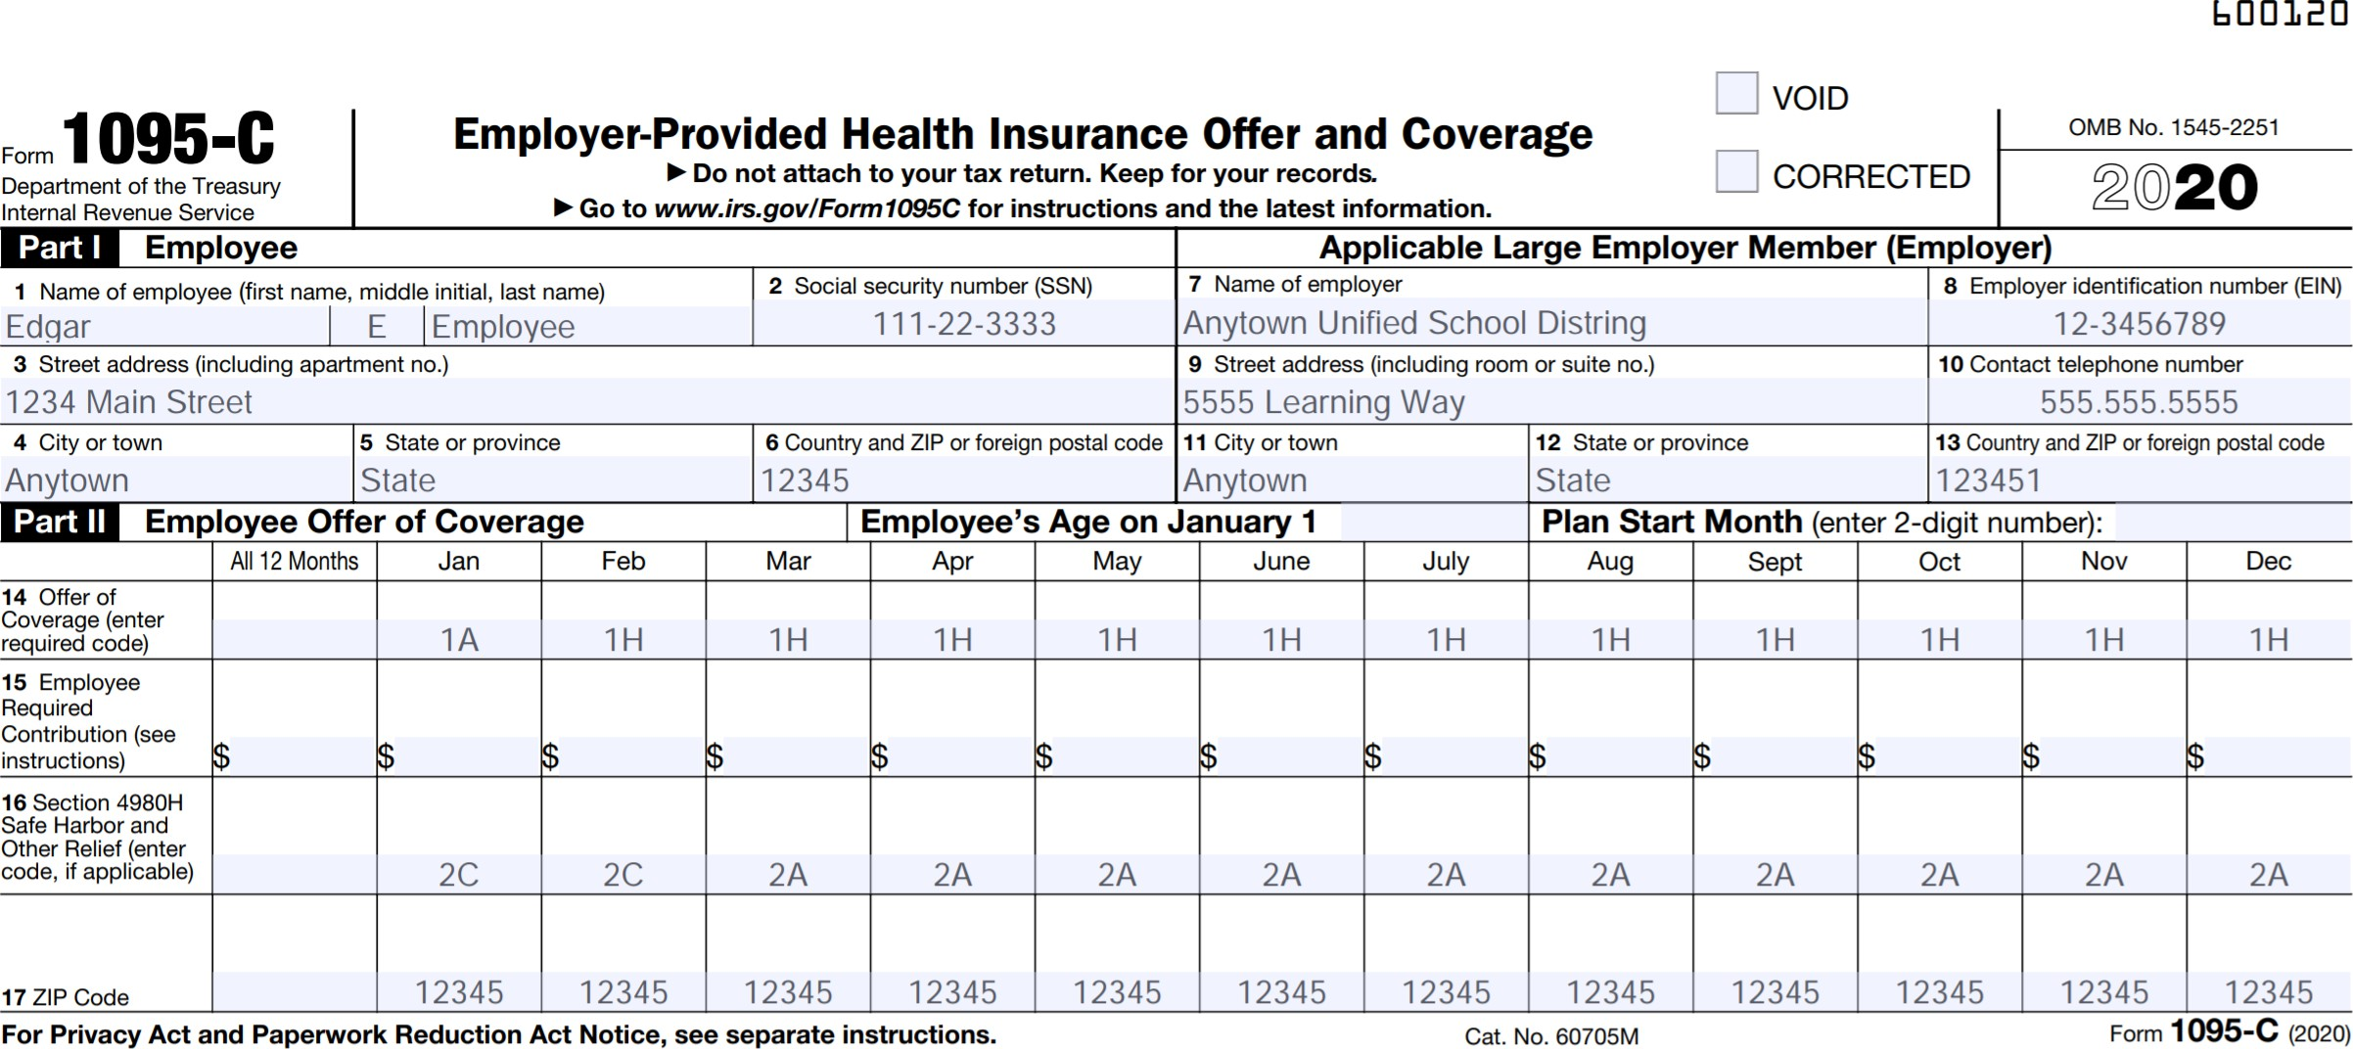
Overreliance On a Computer System
Notes:
ESB-9682-0524
We were recently asked to consult with a group that was using a module in their benefits enrollment. During a review of their forms, we consistently found invalid code combinations when an employee terminated. Here’s an example:
Employee terminated in February. This employee had coverage until the end of the month. The Form 1095-C Section II coding for the month of February was as follows 1H/Blank/2C for lines 14, 15 and 16,
Line 14: 1H (meaning no offer)
1A or 1E could be used as this employee still had an offer of coverage. However 1H/Blank/2C combination would not be a valid code combination according to IRS Form 1095-C instructions.
Line 15: Blank
This is correct for 1A in line 14, however if the employer uses 1E as the offer code line 15 should show the medical plan rate for the lowest cost an employee would pay out of pocket.
Line 16: 2C
Indicating the employee had coverage that month, which they did.
We’ll talk in a few minutes about the kind of penalty risk a small mistake like this can generate. First, though, let’s look at some other common ways employers are sabotaging their compliance.

Slide 36
Human Error
Happens more often than many realize
Employer formats the data incorrectly.
Many third-party companies that provide ACA service still require you to format your data in their exact templates.
Keep in mind, ACA output is only as good as the data that is imported.
Notes:
ESB-9682-0524
When it comes to ACA reporting, human error is a significant factor that often goes under the radar but can have substantial consequences. It's not uncommon for employers to format data incorrectly, which can lead to errors in the final reports submitted to the IRS.
Many of us rely on third-party companies to provide ACA reporting services. However, it's important to remember that these services often require us to format our data to fit their specific templates. This step is critical because any mistakes in data entry or formatting can carry through to the final report, leading to potential compliance issues.
The key takeaway here is that the output of our ACA reporting—the forms and information we submit to the IRS—is only as accurate as the data we import into these systems. This means that meticulous attention to detail is necessary when preparing our data for submission, whether we're doing it in-house or using a third-party service.

Slide 37
Human Error
Employer accidently sorted demographic data causing the employee to have the address of another employee. Forms 1095-C were distributed to the wrong employee for more than 800 employees!
This created:
Several hours of rework to reissue forms.
Notification to employees.
Notification to internal data security contact as employees received other employees' data (including last four of social security).
Notes:
ESB-9682-0524
Read slide.
Each state may have different rules for how to handle this situation. Follow company procedures to ensure correct communication and process is followed to comply with any company and/or state security data risk concerns. May even require legal counsel.

Slide 38
Do you know how to answer these?
Letter 226J
Letter 5005-A
Letter 972CG
CP215
CP504B
Letter 5699
Letter 5698
Letter 1865C
Letter 3064C
Letter 1948C
Notes:
ESB-9682-0524
Read slide.

Slide 39
Prepared for an audit?
If you receive a proposed penalty assessment letter from IRS for a tax year that was three+ years ago, could you quickly produce necessary paperwork to reply to the assessment?
Turnover is the biggest issue
Lack of procedures for new employees to follow
Historical data not kept where others could access (or not kept at all)
If using a 3rd party provider, what assistance can they provide?
Notes:
ESB-9682-0524
Read Slide

Slide 40

Audits Underway
Notes:
ESB-9682-0524
One of the most concerning developments is that employers have received letters similar to what you see here. Imagine received a letter like this one, requesting that the calculations they to determine employee status in 2019 and 2020, three or four years ago.
Do you know how you calculated your employees’ hours three or four years ago? How confident are you that you can produce the level of proof, documentation, or authentication the IRS will required to keep you safe from penalty exposure?
This is a very real departure from the way the IRS has assessed penalties in the past, we have heard from employers they will find it challenging to substantiate those calculations, particularly if they’re using “free” options with no documentation.

Slide 41
2020 Audits Underway
$14.1 billion for the IRS
IT enhancements
Identifying ACA non-compliance
10,000 new hires, now available to perform ACA audits
Making good on 2020 charge to improve ESRP assessments
Notes:
ESB-9682-0524
There are several indicators that the IRS is stepping up enforcement. The Biden administration recently requested $14.1 billion in discretionary funds aimed in part at improving their IT infrastructure and updating their processes for identifying ACA non-compliance. The IRS recently hired some 10,000 new employees, many of whom were hired specifically to perform audits for ACA non-compliance as part of their response to a 2020 report by the TREASURY INSPECTOR GENERAL FOR TAX ADMINISTRATION to assess more penalties for ACA non-compliance.
(The report specifically noted that of the $17 billion the IRS could have assessed for the cases in progress through 2019, only $749 million in penalties had actually been proposed. This has motivated the IRS to improve their penalty assessment processes.)
[compliance note: TIGTA report can be found here: https://www.treasury.gov/tigta/auditreports/2020reports/202043028fr.pdf and the specific numbers cited above are on page 3)

Slide 42
An “A” for effort?
No more good faith effort relief
More scrutiny, more enforcement
Standard for reasonable cause waiver much harder to reach
Notes:
ESB-9682-0524
Every year, more and more employers find themselves facing stiff penalties from the IRS for their failure to comply with the reporting requirements of the Affordable Care Act, penalties they thought they could avoid by hiding behind the shield of the “good faith effort” relief.
If you made your best-faith effort to properly and timely furnish and file Forms 1094 and 1095 in previous years, you may well have some protection from penalties for minor reporting errors with this relief, which was designed to give employers who made a good effort a bit of grace if the forms were incomplete or inaccurate. But if you, like some employers we’ve met, failed to furnish or timely file at all, you might find yourself holding an IRS penalty letter with no good faith effort relief to protect you.
We recently worked with an employer in just that situation – they received Letter 226J from the IRS indicating they owed an Employer Shared Responsibility Payment (ESRP). The surprised employer appealed the assessment, only to have their penalty, which totals more than $100,000 for a single year of failing to file the forms, reaffirmed by the IRS. Even a thorough accounting of the efforts they made to remedy the failure and prevent future mistakes failed to sway the IRS, who said none of the contributing circumstances met the requirements of the good faith effort relief.
The culprit? A simple combination of employee turnover, ambiguous departmental responsibilities, and business priority.
You should note that while this employer was penalized in a year where good faith effort relief was offered, reporting requirements have only become more stringent. The IRS no long offers good faith effort relief for inaccurate or incomplete forms, and it is likely we will see an increase in the kind of enforcement this employer faced.

Slide 43
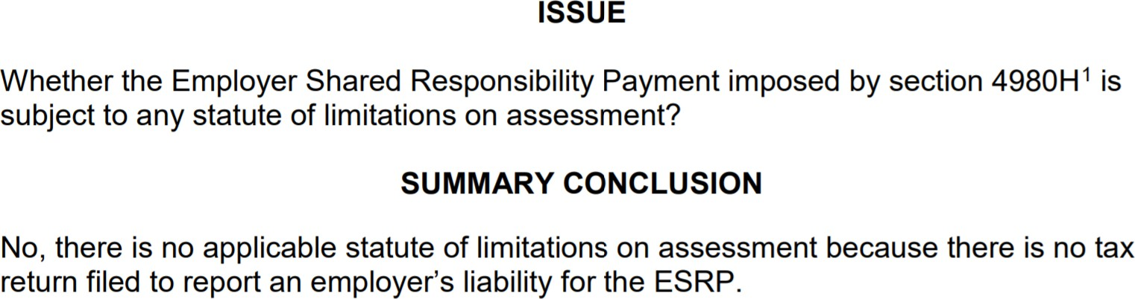
No Statute of Limitations
https://www.irs.gov/pub/irs-lafa/20200801f.pdf
Notes:
ESB-9682-0524
Read slide.

Slide 44
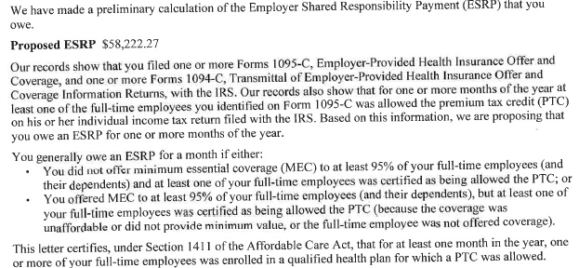
Real world example
Notes:
ESB-9682-0524
Read slide.

Slide 45
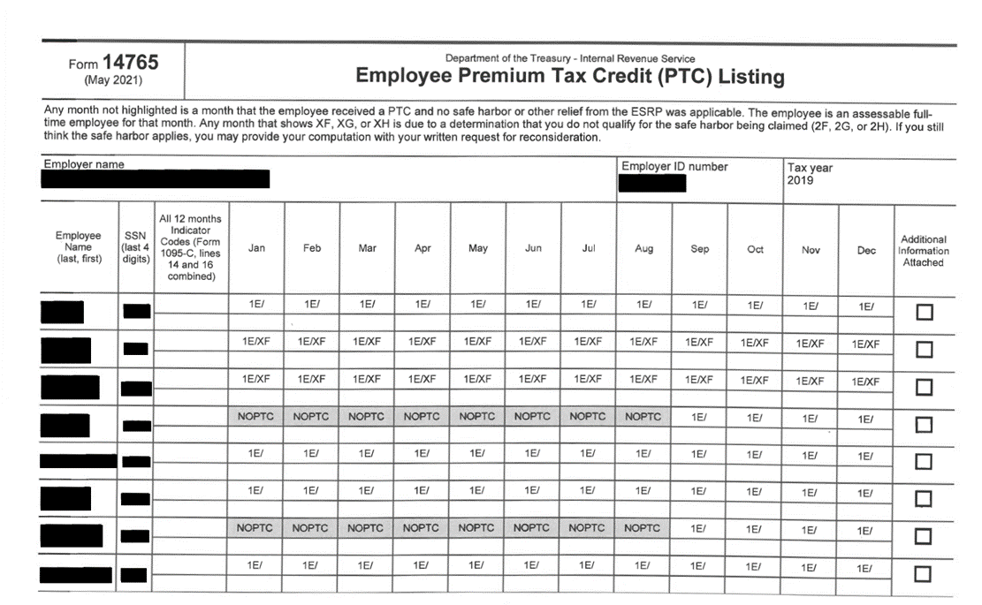
Overreporting equals hassle
Notes:
ESB-9682-0524
Employers have issued forms (and subsequently reported to the IRS) about offers of coverage to more than 200k part-time employees who did not qualify as full-time under the law. This overreporting leads the IRS to believe that these employees qualified for an offer of coverage. If one was not made, and the employee received a premium tax credit, the IRS could issue a penalty assessment. This would result in headaches for your staff as they lose time and productivity making the case against a penalty assessment you should never have received at all.
One explanation for this that it is administratively too difficult to track hours to accurately determine ACA Full Time status, so sending forms to everyone will protect against this risk. Another explanation is that reporting decisions were previously made at leadership or Board levels and there hasn’t been any motivation to update these decision.
Employers who think they’re taking a shortcut by issuing all employees a form are really just setting themselves up for frustration and more work down the road.
Consider this example. A school district insists on issuing a form to all 665 employees. Some 20% (142) of those employees are not full-time under the law and should have receive a form. Some of those employees go to the Marketplace and receive a premium tax credit, and because they are being reported as full-time, the employer is assessed a penalty. Now, members of the HR team are forced to research each employee in the list to prove they were not full-time, taking away valuable time from mission-critical tasks and putting pressure on the administrative staff.

Slide 46
Overreporting equals real risk
142 x $620 = $88,040
Notes:
ESB-9682-0524
With the end of good faith effort relief, the IRS is expected to more strictly enforce penalties for inaccurate forms. This is where overreporting could have real monetary consequences. The penalty for furnishing an inaccurate form to an employee is $310 per form. This stacks with an additional $310 penalty for filing that incorrect form with the IRS. In the example from our previous slide, the employer may avoid an A penalty, but still incur a more than $80k penalty for furnishing and filing inaccurate forms.

Slide 47
Affordability Safe Harbors
2025 ACA affordability increases to 9.02%
FPL safe harbor: no more than $113.20 or less per month for calendar year plans
Rate of Pay and Form W-2 safe harbor amounts will also shrink
Many reporting penalties are assessed for incorrect or inapplicable Safe Harbor Codes being used
Notes:
ESB-9682-0524
The IRS has announced that the ACA affordability percentage used to determine compliance with the employer mandate decreased from 9.12% in 2023 to 8.39% of the employee’s household income in 2024. In addition to making it more difficult to use the federal poverty level safe harbor, this will change the rate of pay and Form W-2 safe harbor calculations, and may mean that employees you were able to claim a safe harbor on for 2023 no longer qualify. Remember, the most significant impact of this change is on the population of employees who are offered but waive your employer-sponsored coverage. As we will review later, when any one of those employees works at a full-time level under ACA rules and obtains subsidized coverage in the Marketplace, they can trigger a potential ACA penalty for you. This makes managing “B” penalty (affordability) liability more challenging for employers.

Slide 48
Understanding Affordability Safe Harbor Codes
2F – W-2 wages Safe Harbor
2G – Federal Poverty Line (FPL) Safe Harbor
2H – Rate of Pay Safe Harbor
Notes:
ESB-9682-0524
Read Slide

Slide 49
Line 16 code 2F W-2 Safe Harbor
Multiply Box 1 wages by the annual affordability percentage
Compare that number to the employee’s required annual contribution for the lowest-cost, employee-only plan
You must adjust for partial-year coverage
Notes:
ESB-9682-0524
Now we come to the first of our three affordability safe harbor codes. In this scenario, you multiply the Box 1 wages from the employee’s Form W-2 by the annual affordability percentage. Then, you compare that number to the employee’s required annual contribution for the lowest-cost, employee-only plan.
If the employee’s required contribution is equal to or lower than the result of that calculation, you are eligible to use the W-2 affordability safe harbor.
Some employers find this method burdensome, because you must wait until you have the data required to fill out the W-2 before you can calculate this number. It’s worth remembering that Box 1 wages have certain pre-tax transactions excluded, so you cannot simply use their annual salary in this calculation.

Slide 50
Line 16 code 2G FPL Safe Harbor
Multiply the applicable federal poverty line by the annual affordability percentage and divide by 12
Compare that number to the employee’s required monthly contribution for the lowest-cost, employee-only plan
2024 calendar year plan: $101.94/mo
2025 calendar year plan: $113.20/mo
Notes:
ESB-9682-0524
This code is tricky, there’s no denying that. Not only is the calculation different based on whether your employee resides in the CONUS or in Alaska or Hawaii, you have the option to use the federal poverty level in effect on the first day of the plan year, or to use the federal poverty level in effect six months prior to the first day of your plan year.
For example, a plan that begins in 2023 would use the 9.12% to calculate affordability For calendar year you would use the prior year federal poverty level; 13,590 (for 2022)* 9.12% = 103.28/month. If it is a non-calendar year then you would use current year federal poverty level; $14,580 (for 2023) * 9.12% = $110.81/month.
Let’s shift gears for just a moment. As an employer, you might be looking ahead to your next plan year, trying to determine what rates will comply with the law’s affordability requirements. For calendar year plans beginning January 1, 2024, the maximum monthly contribution is $101.94.
Read slide.

Slide 51
Line 16 code 2H Rate of Pay Safe Harbor
For an hourly employee, multiply the employee’s rate of pay by 130 hours by the annual affordability percentage
For a non-hourly employee, multiply their monthly salary beginning on the first day of the coverage period by the annual affordability percentage
Compare that number to the employee’s required monthly contribution for the lowest-cost, employee-only plan
Notes:
ESB-9682-0524
The hardest part of this safe harbor is knowing what rate of pay to use. But Jessica, rate of pay is super straightforward. This is their wage, that’s the number!
The law is very clear that for any employee who had a change in their rate of pay during the year, you have to use the rate of pay that’s most advantageous to them. In short, you have to use the lower amount.
Here’s what the law says, in all of its legalese: you must use the lower of “the employee’s hourly rate of pay as of the first day of the coverage period (generally the first day of the plan year)
or the employee’s lowest hourly rate of pay during the calendar month.”
In plainer speech, you have to look at the employee’s hourly rate of pay on the first day of the coverage period. Then, look at the lowest rate of pay during the calendar month you’re reporting on. Whichever number is lower is the number you have to use in your calculation. This same standard is applied to the monthly salary of a non-hourly employee. If the monthly salary is reduced, including for a reduction of hours, the safe harbor is not available.

Slide 52
Electronic Filing of ACA Forms
Previously required for 250 or more forms
Now required for employers filing 10 or more total forms, including Forms W-2
Challenging for smaller employers with limited resources
Notes:
ESB-9682-0524
For more than half a decade, employers have been filling out required ACA forms, sending them to employees, and filing those forms with the IRS. And for employers with fewer than 250 forms, that filing process could be fairly straightforward – they had the option to print the forms and mail them off. New regulations, though, mean that this process will become more involved when employers file their 2023 tax year forms in early 2024.
Recently issued final regulations implement Section 2301 of the Taxpayer First Act and will dramatically expand the electronic filing rules. Under the new regulations, any employer who files 10 or more aggregate returns will now be required to file electronically. This change could prove challenging to many employers who have previously relied on the ability to file paper copies and who may not have updated systems in place to comply with the new requirements.
Many small employers find it challenging to have the resources to setup electronic filing for ACA. If an employer does not have an electronic filing solution set up, they will want to either complete the process to complete within their organization or work with a third party to help with their ACA filing including their electronic submission. [The good news is ACAChamp is a solution to not only filing electronically but also designed to simplify the complex compliance and cost-management challenges employers face. I have included a brochure in your handouts for your review.]
[compliance note: The information in the slide and notes with [ ] is only to be used when promotion of the service is permissible. ]

Slide 53
IRS Reporting Penalties
https://www.irs.gov/payments/information-return-penalties
Notes:
ESB-9682-0524
Read slide.

Slide 54
IRS Reporting Penalties – due in 2025
Notes:
ESB-9682-0324
Read slide.

Slide 55
IRS Reporting Penalties – due in 2025
Notes:
ESB-9682-0524
Read slide.

Slide 56
Questions?
Kim Bruggeman
kim.bruggeman@AFASTech.com
405-523-5312
acachamp.com
Notes:
ESB-9682-0524
Read slide.

